Slide 1
Telemetry (Power BI) app usage scenarios

Slide 2
Usage
Errors
Performance
Administration

Slide 3
Usage

Slide 4
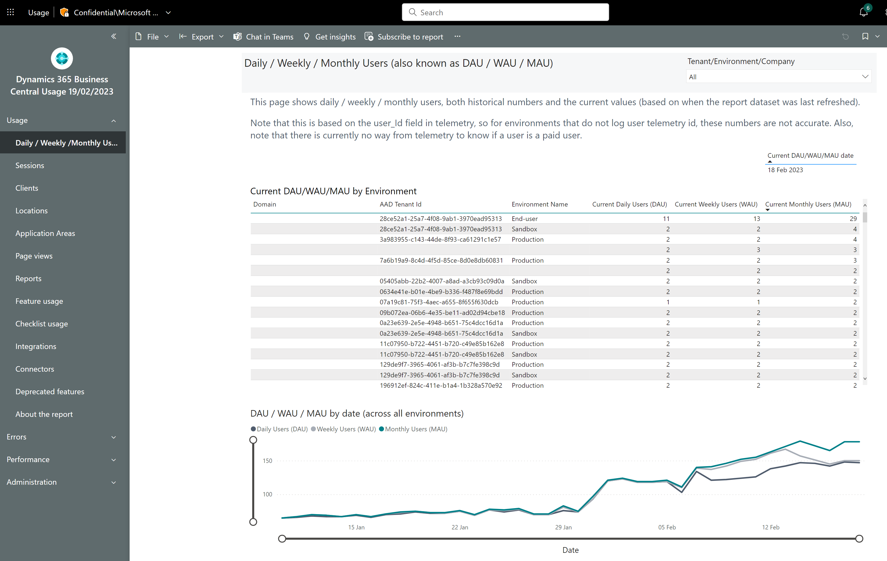
Track daily/weekly/monthly usage
See current usage
Track usage numbers over time

Slide 5
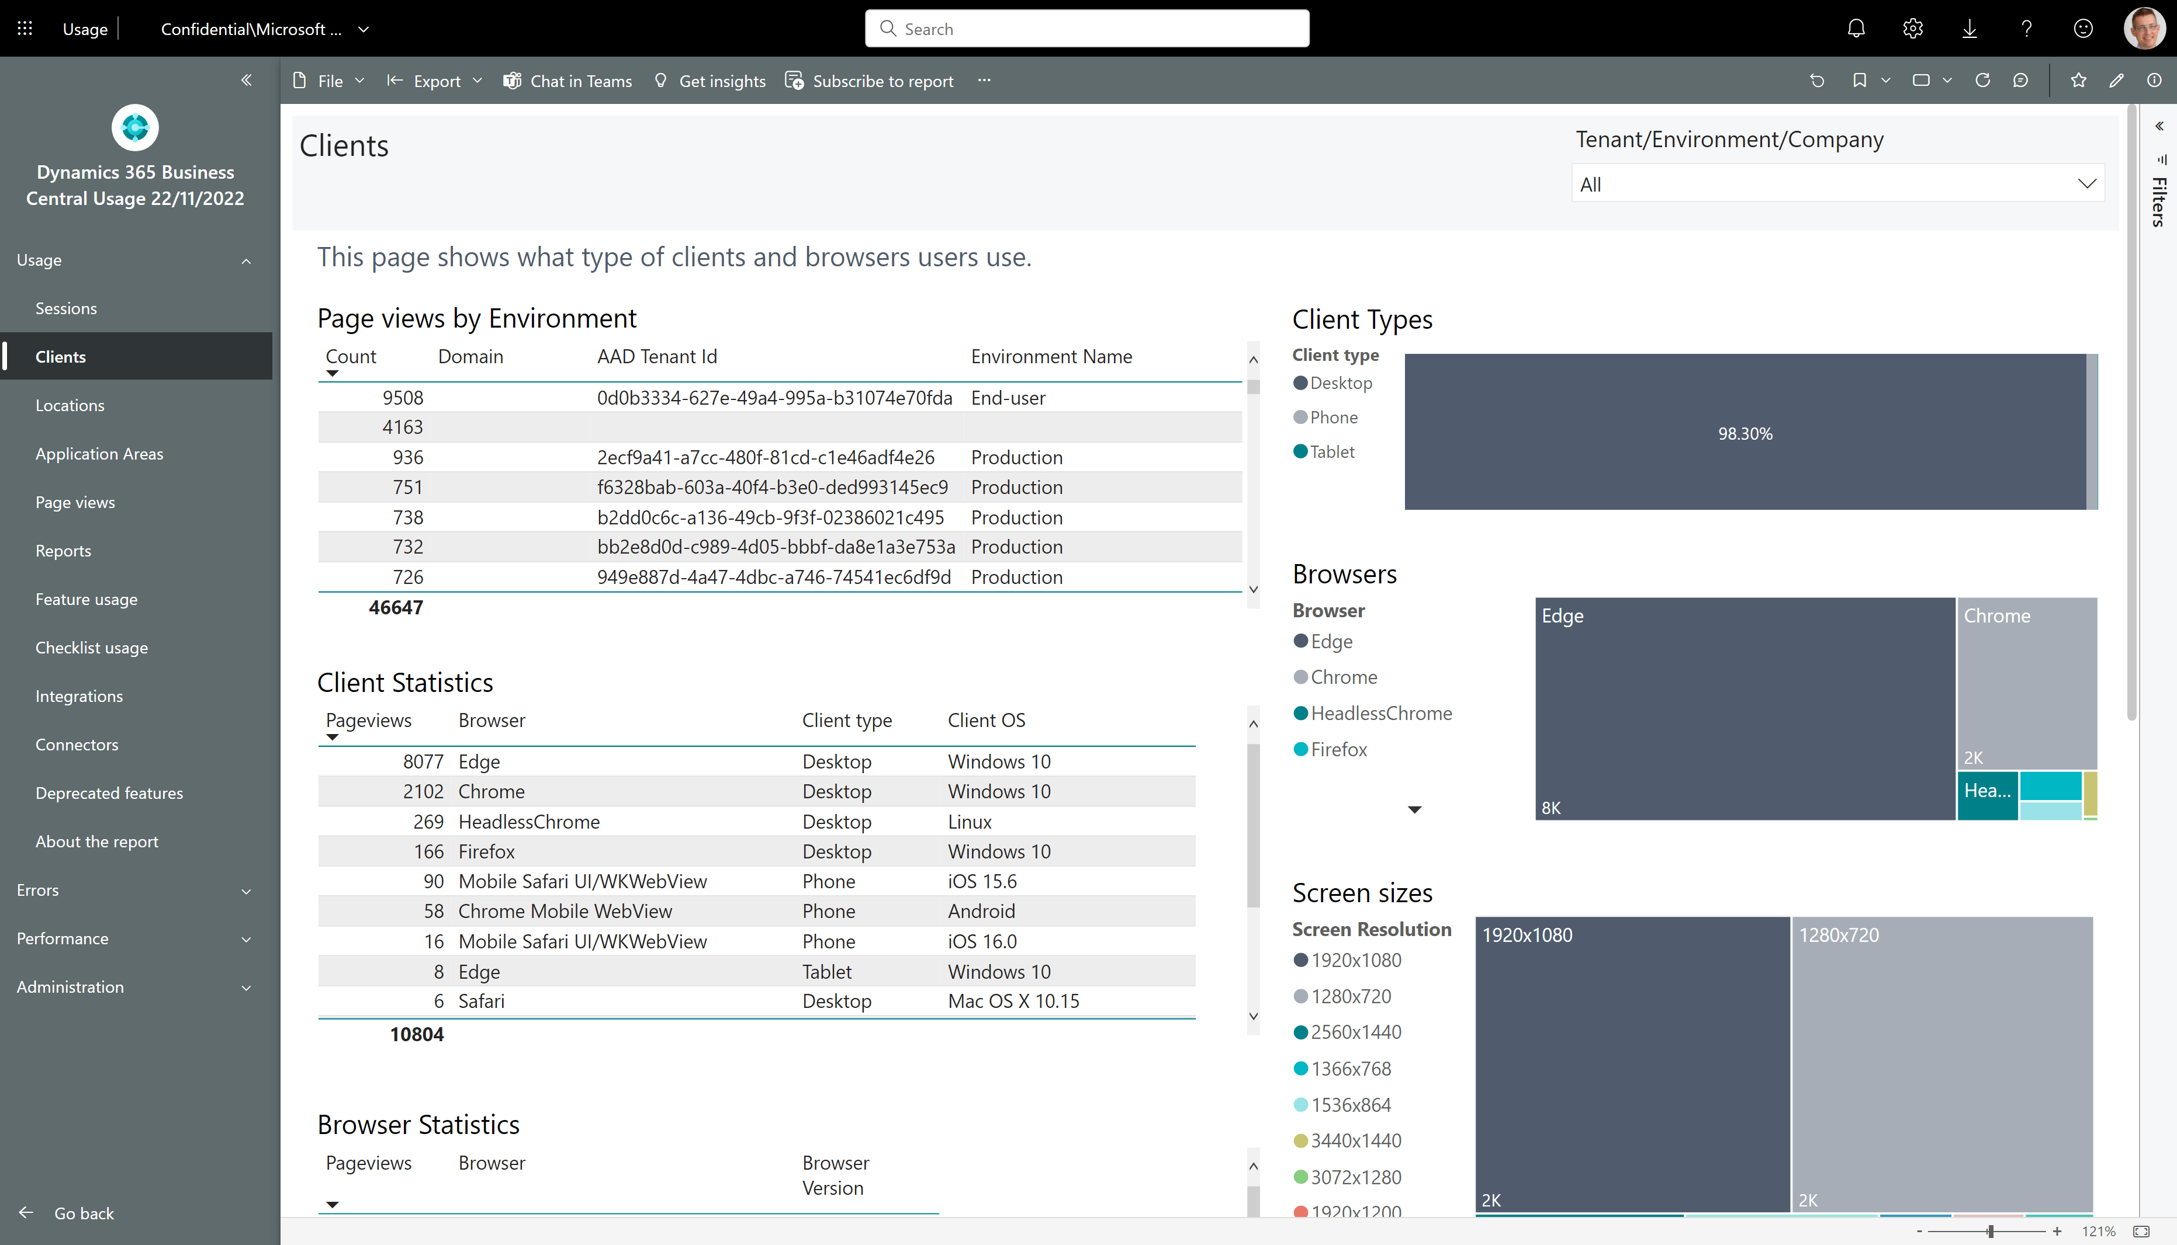
How to see which clients the users at customer use

Slide 6
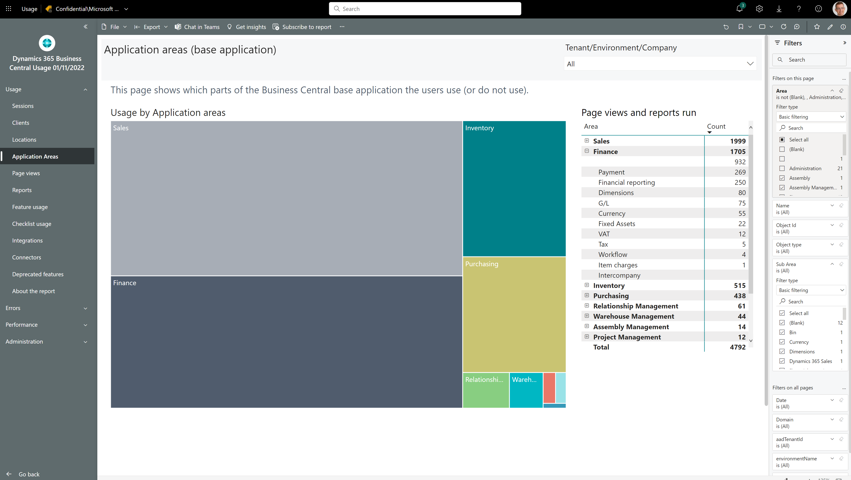
How to see which standard features customers use
Notes:
Filter away Areas with Empty, Bland, Administration, or Other

Slide 7
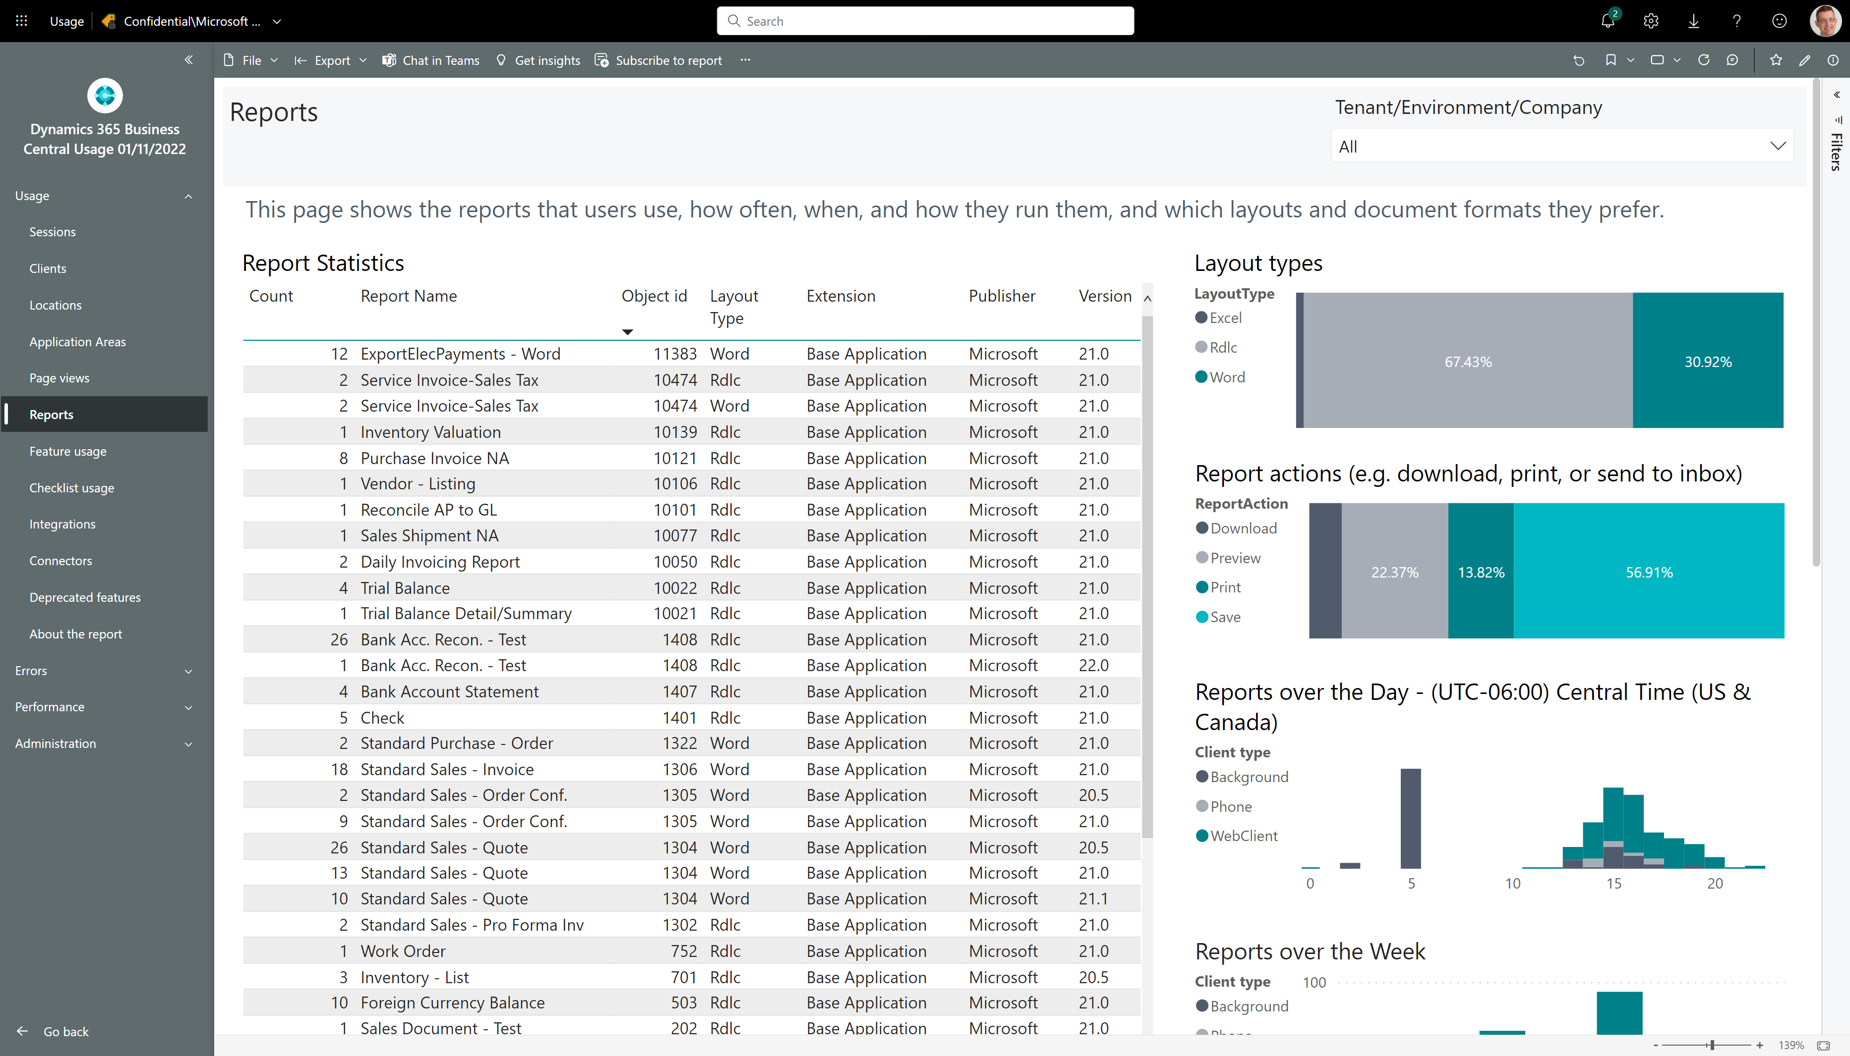
How to see if customer is using Excel layouts

Slide 8
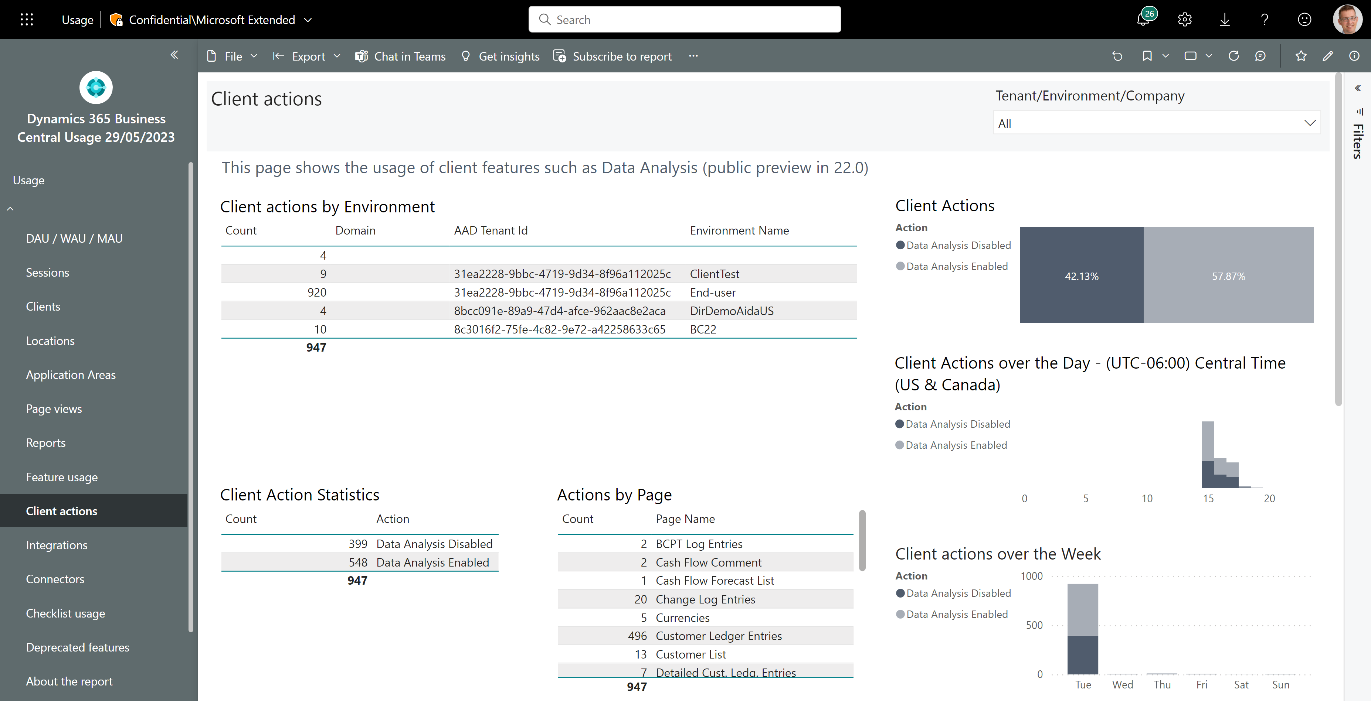
How to see if customer is using Data Analysis
Usage across customers
On which pages do they analyze data?

Slide 9
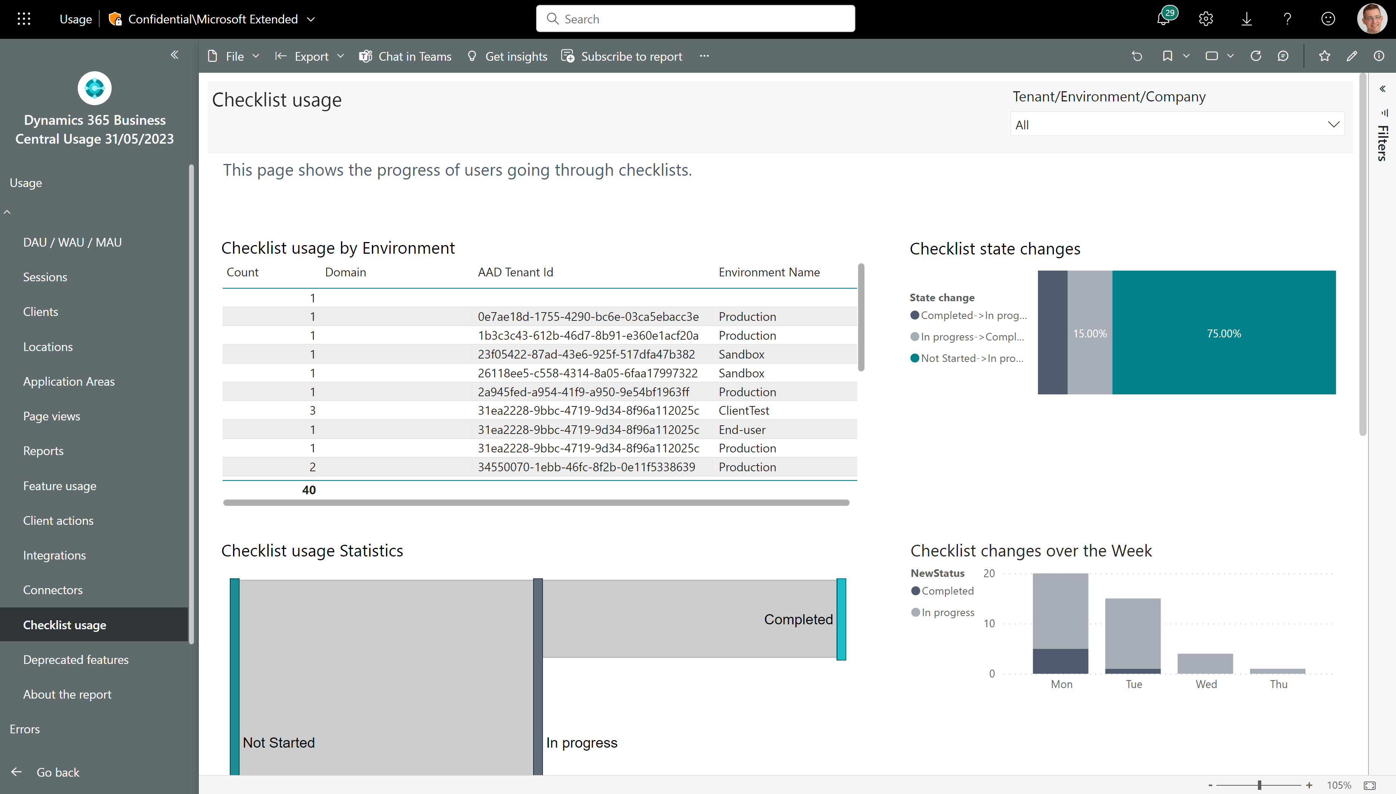
How to follow up on onboarding activities
Track checklists across customers
Track checklist progress

Slide 10
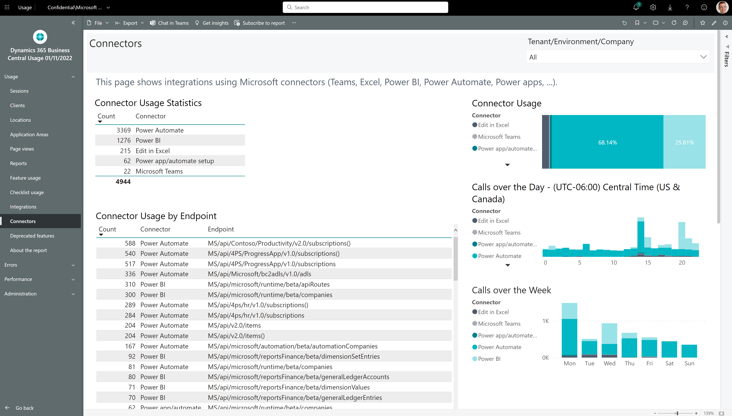
How to see if customer is using Microsoft connectors

Slide 11
Errors

Slide 12
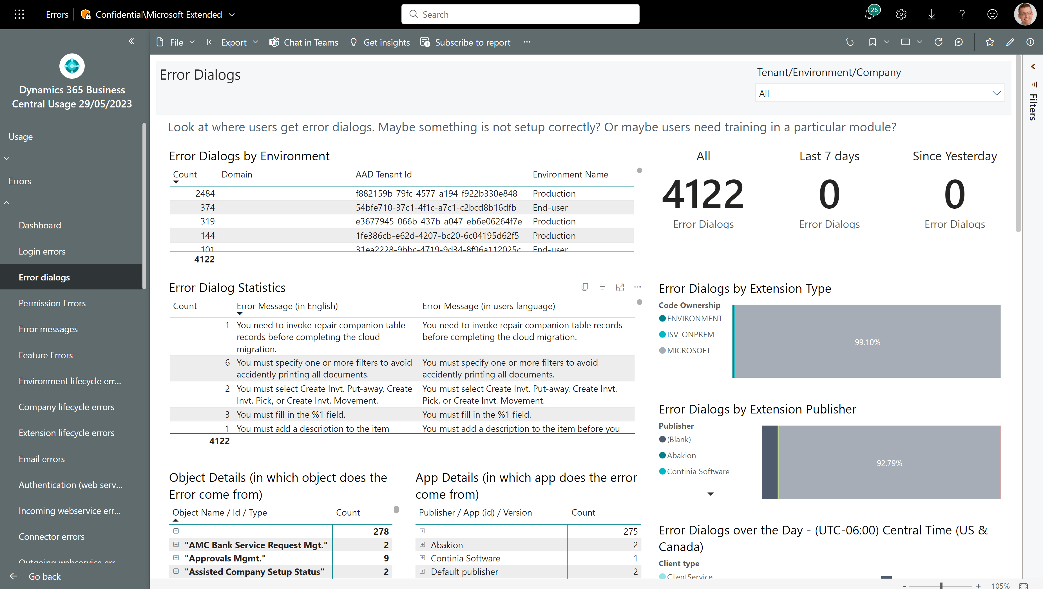
Troubleshoot errors that users see
Which customers experience errors?
What errors do users see?
And what is the error message in English?
Which apps and objects do errors come from?

Slide 13
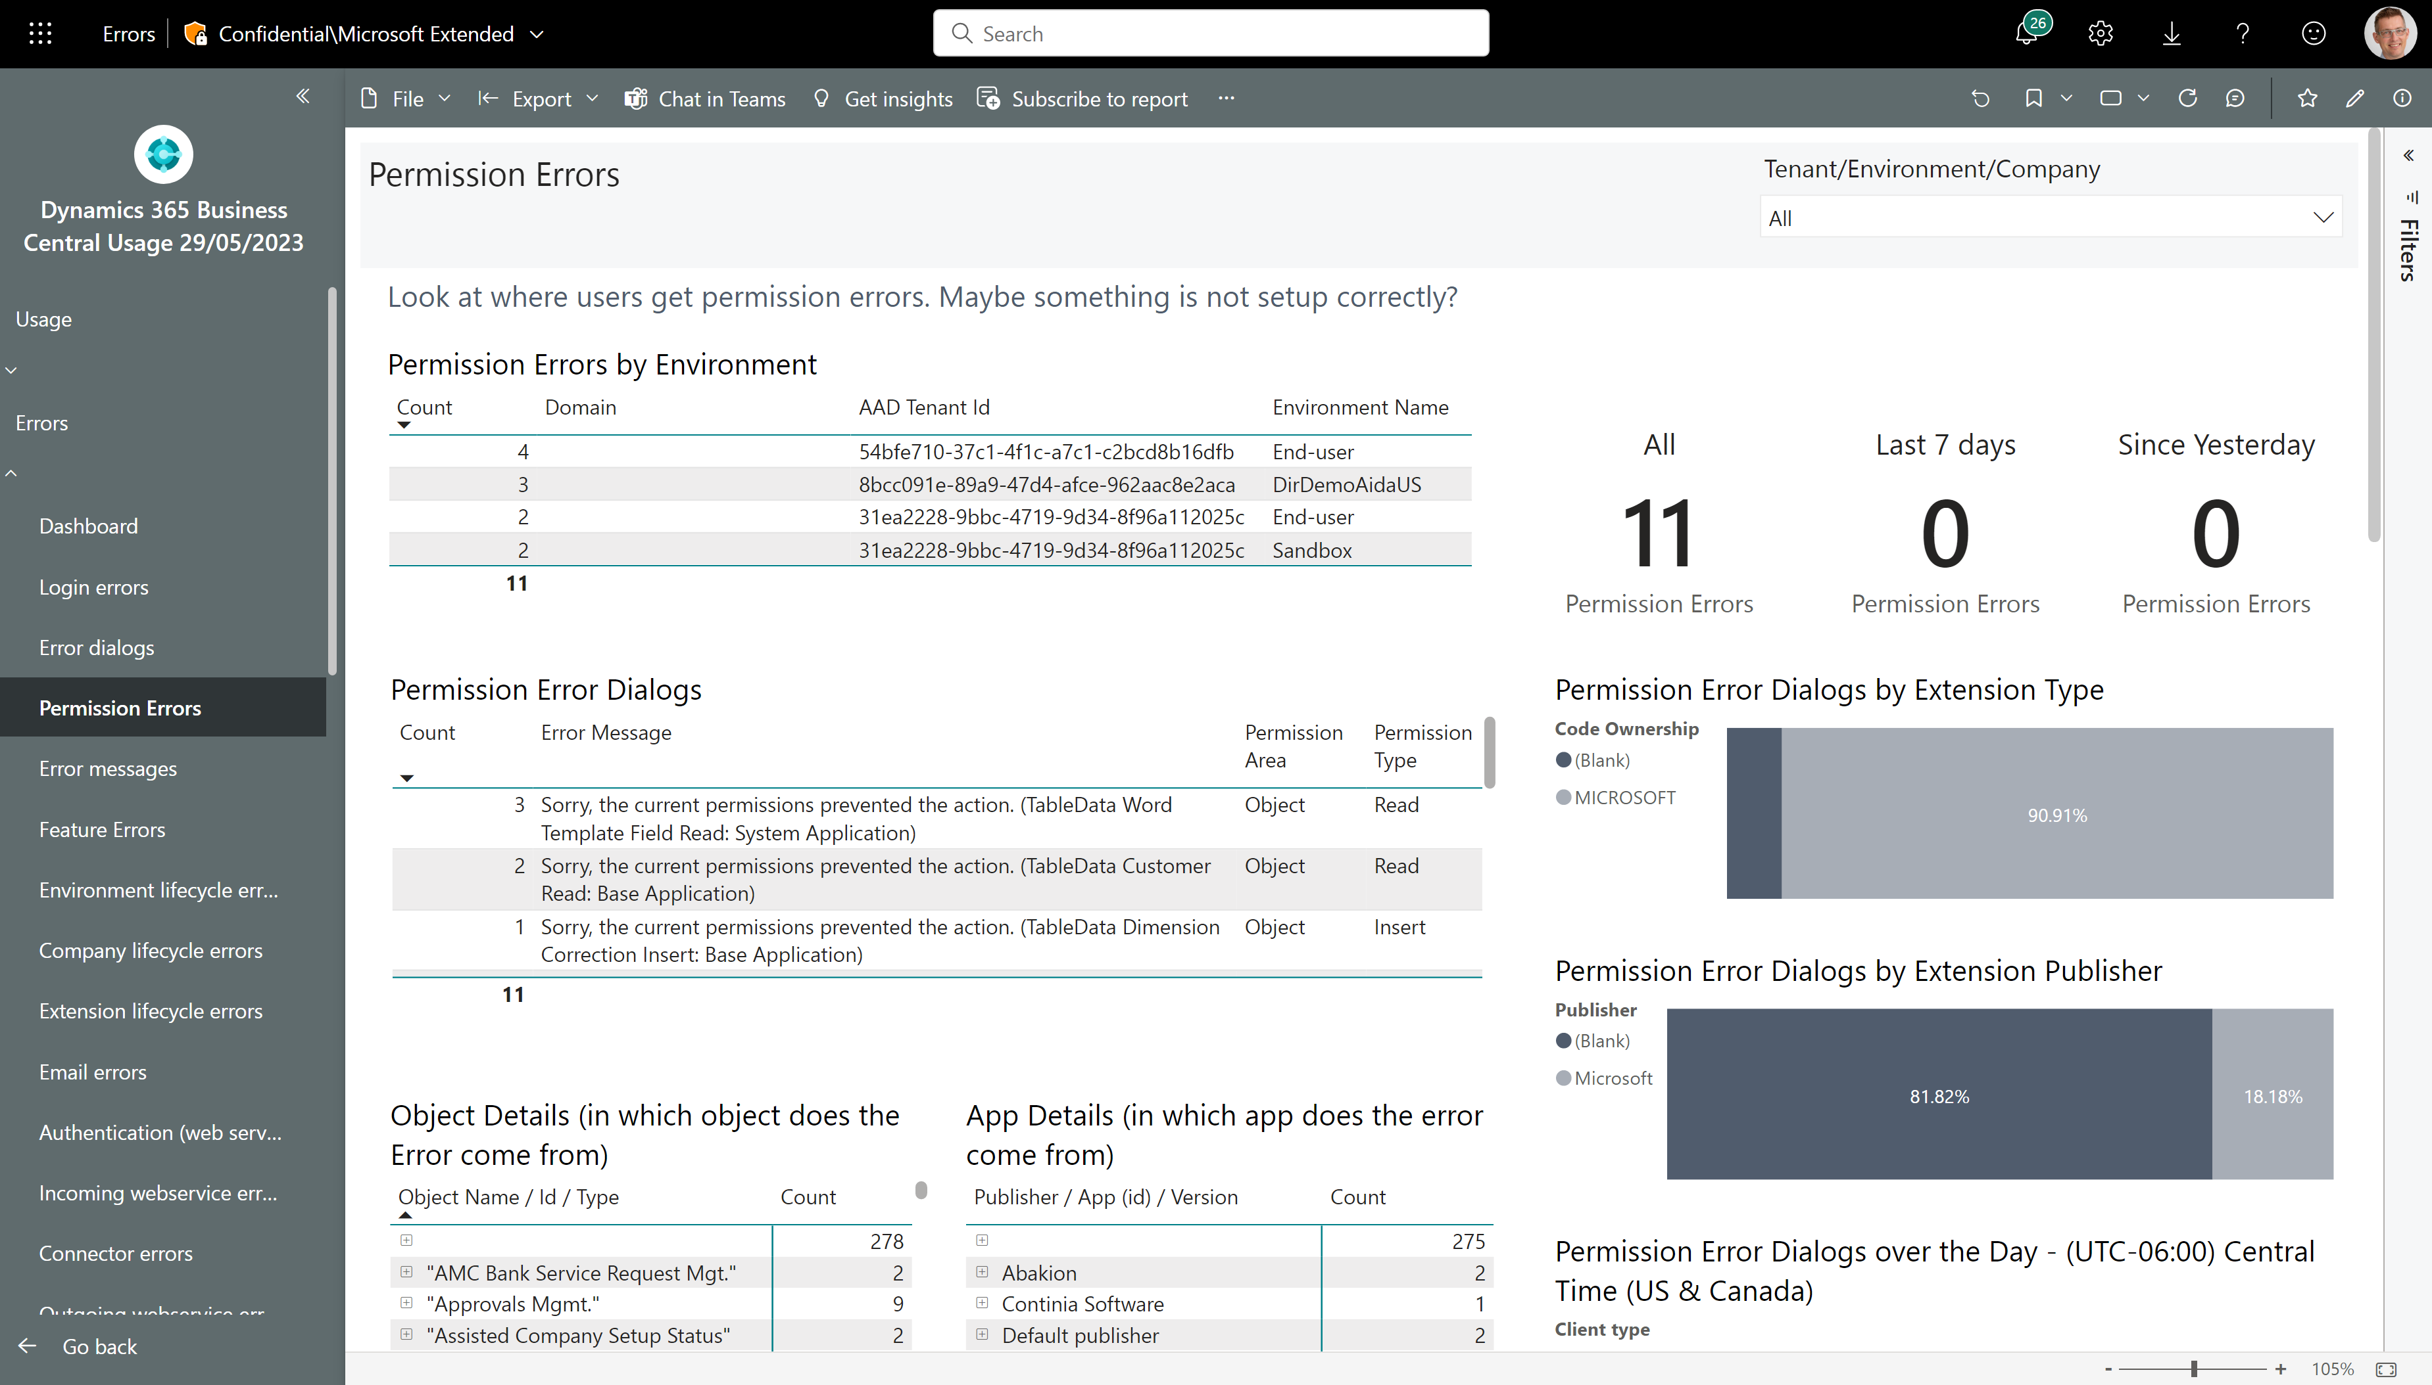
Troubleshoot permission issues
Which customers experience permission issues?
What errors do users see?
Which apps and objects do errors come from?

Slide 14
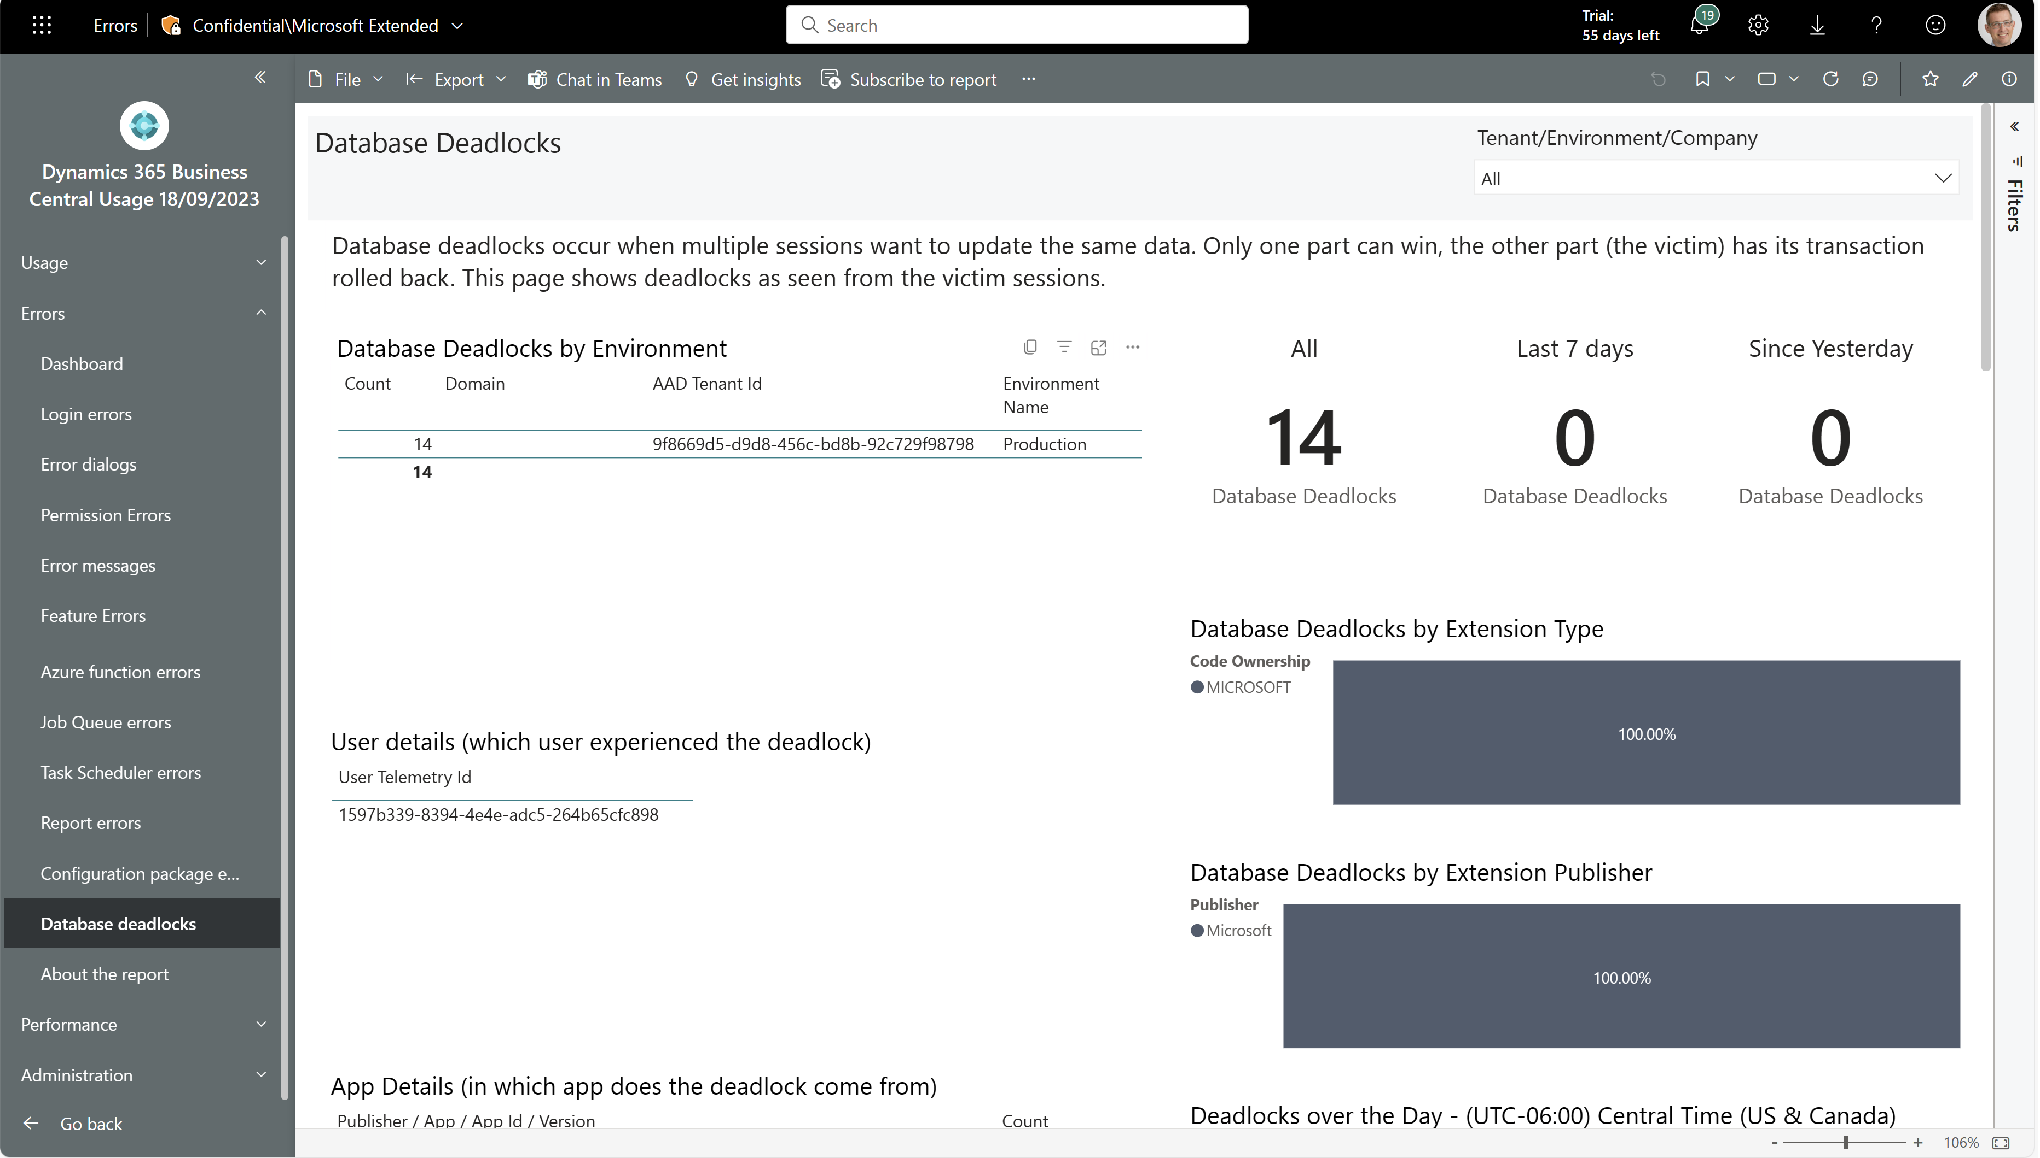
Troubleshoot deadlock issues
Which customers experience deadlocks?
Who got the error?
Which apps and objects do deadlocks arise?

Slide 15
Performance

Slide 16
Tuning login performance
Bad things that should not happen in the OnCompanyOpen trigger
Long running AL methods
Long running SQL statements
Lock timeouts
Outgoing web service calls

Slide 17
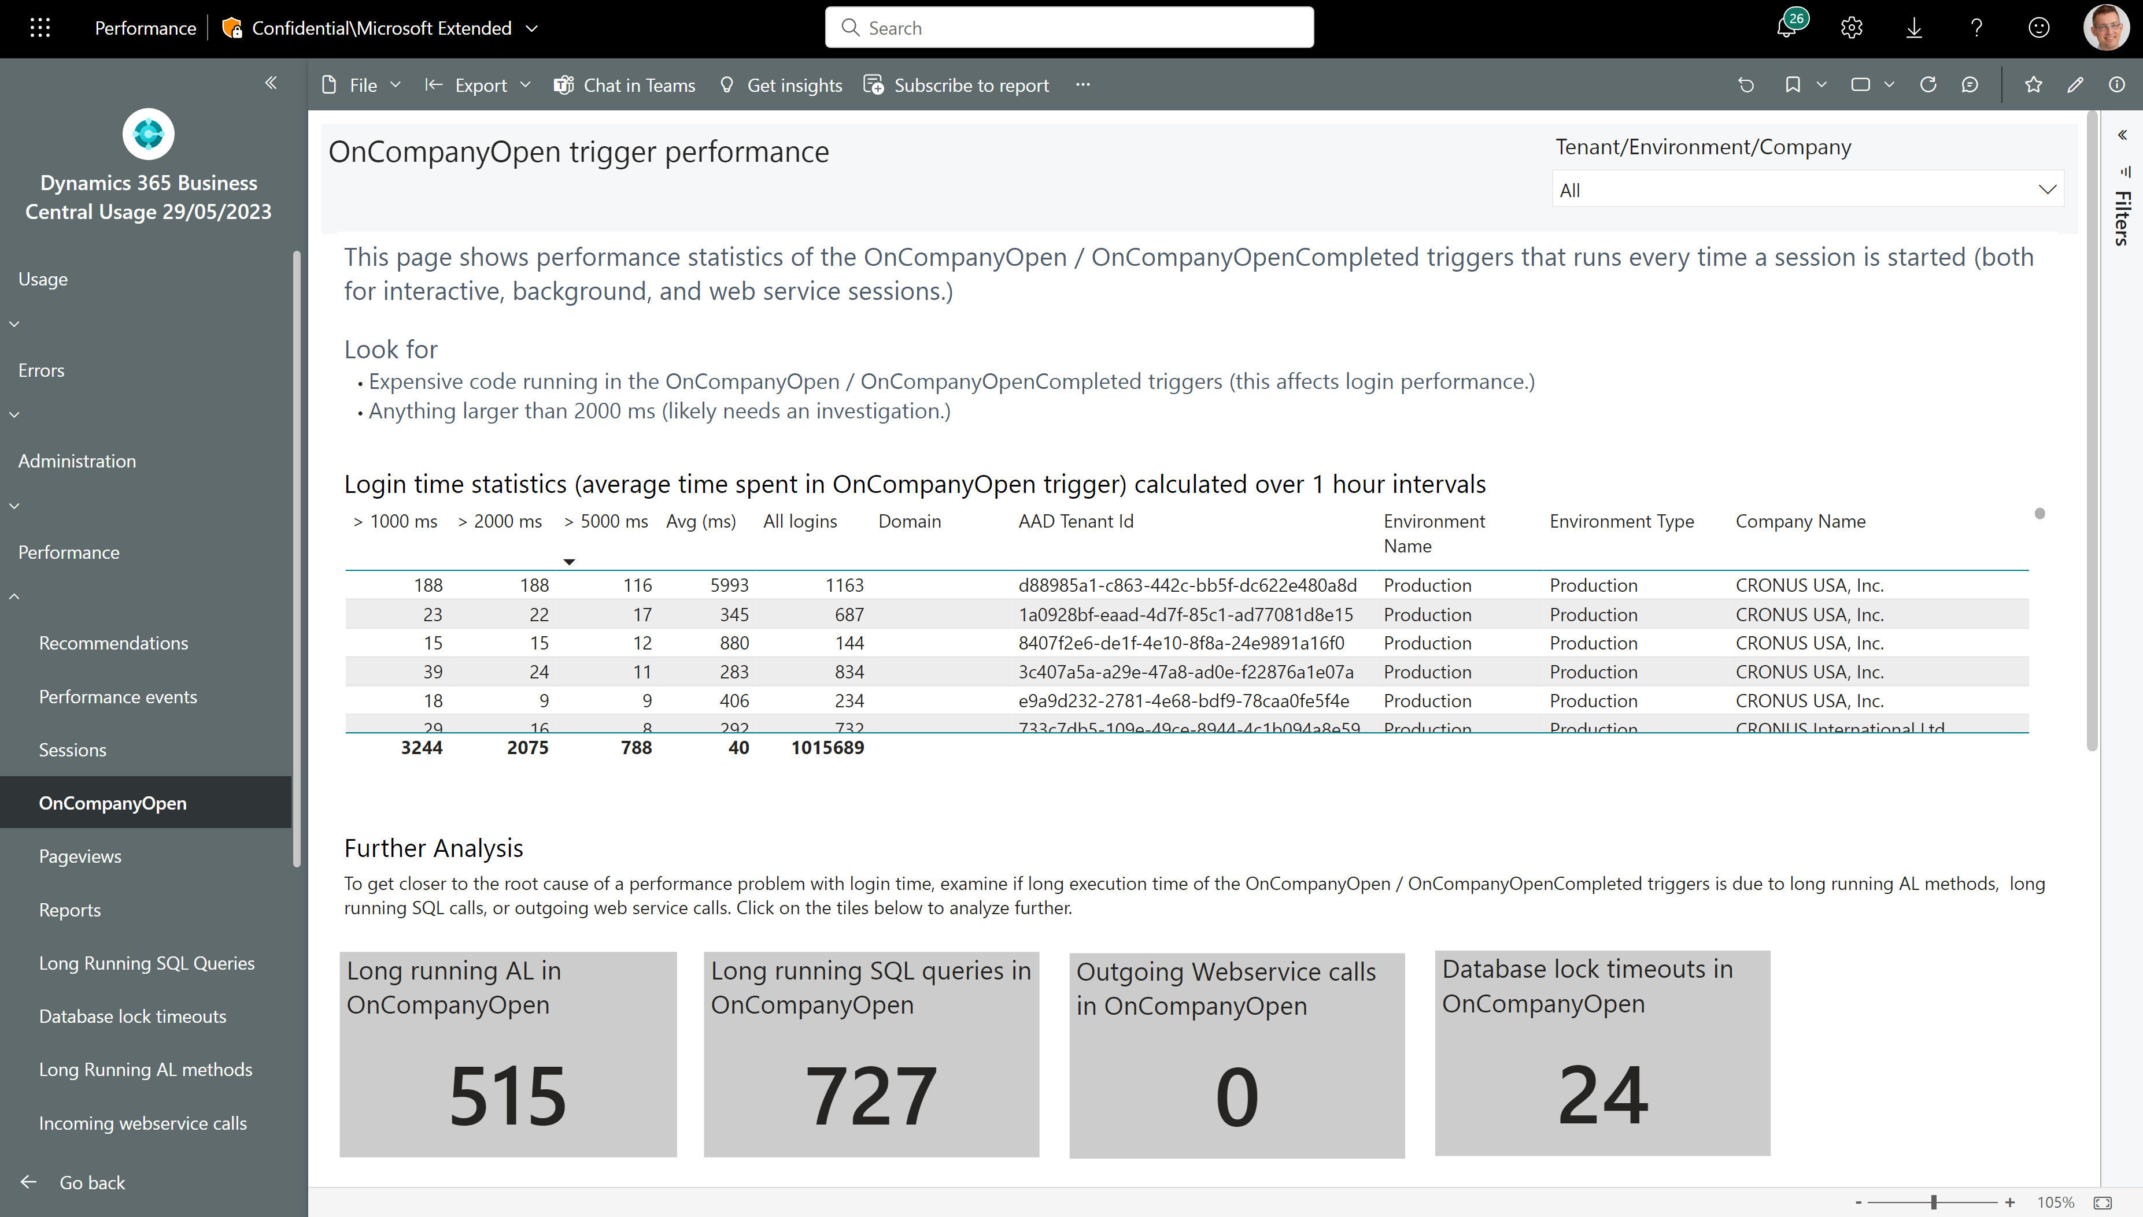
Login performance
None of these should happen

Slide 18
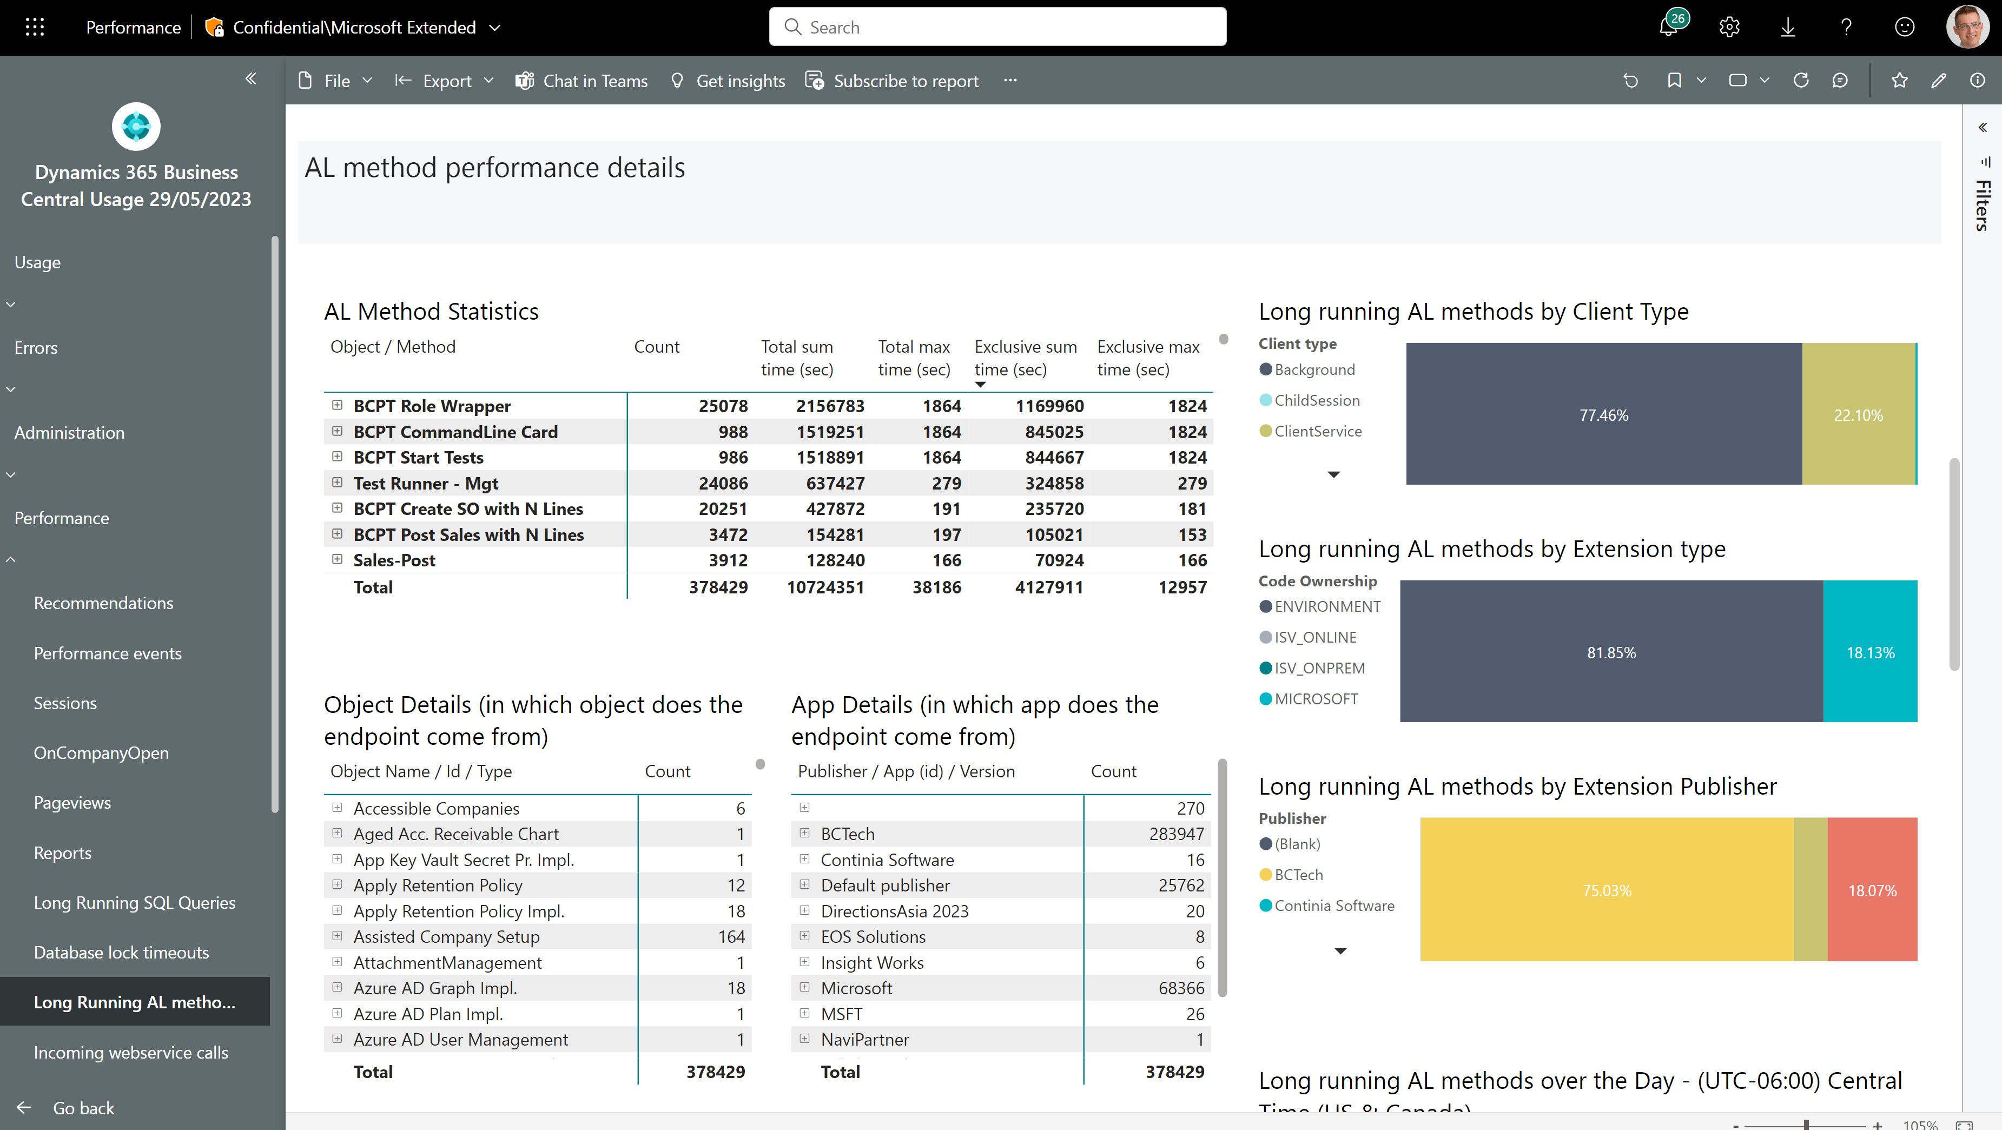
Long running AL methods
Now shows both total time and exclusive time

Slide 19
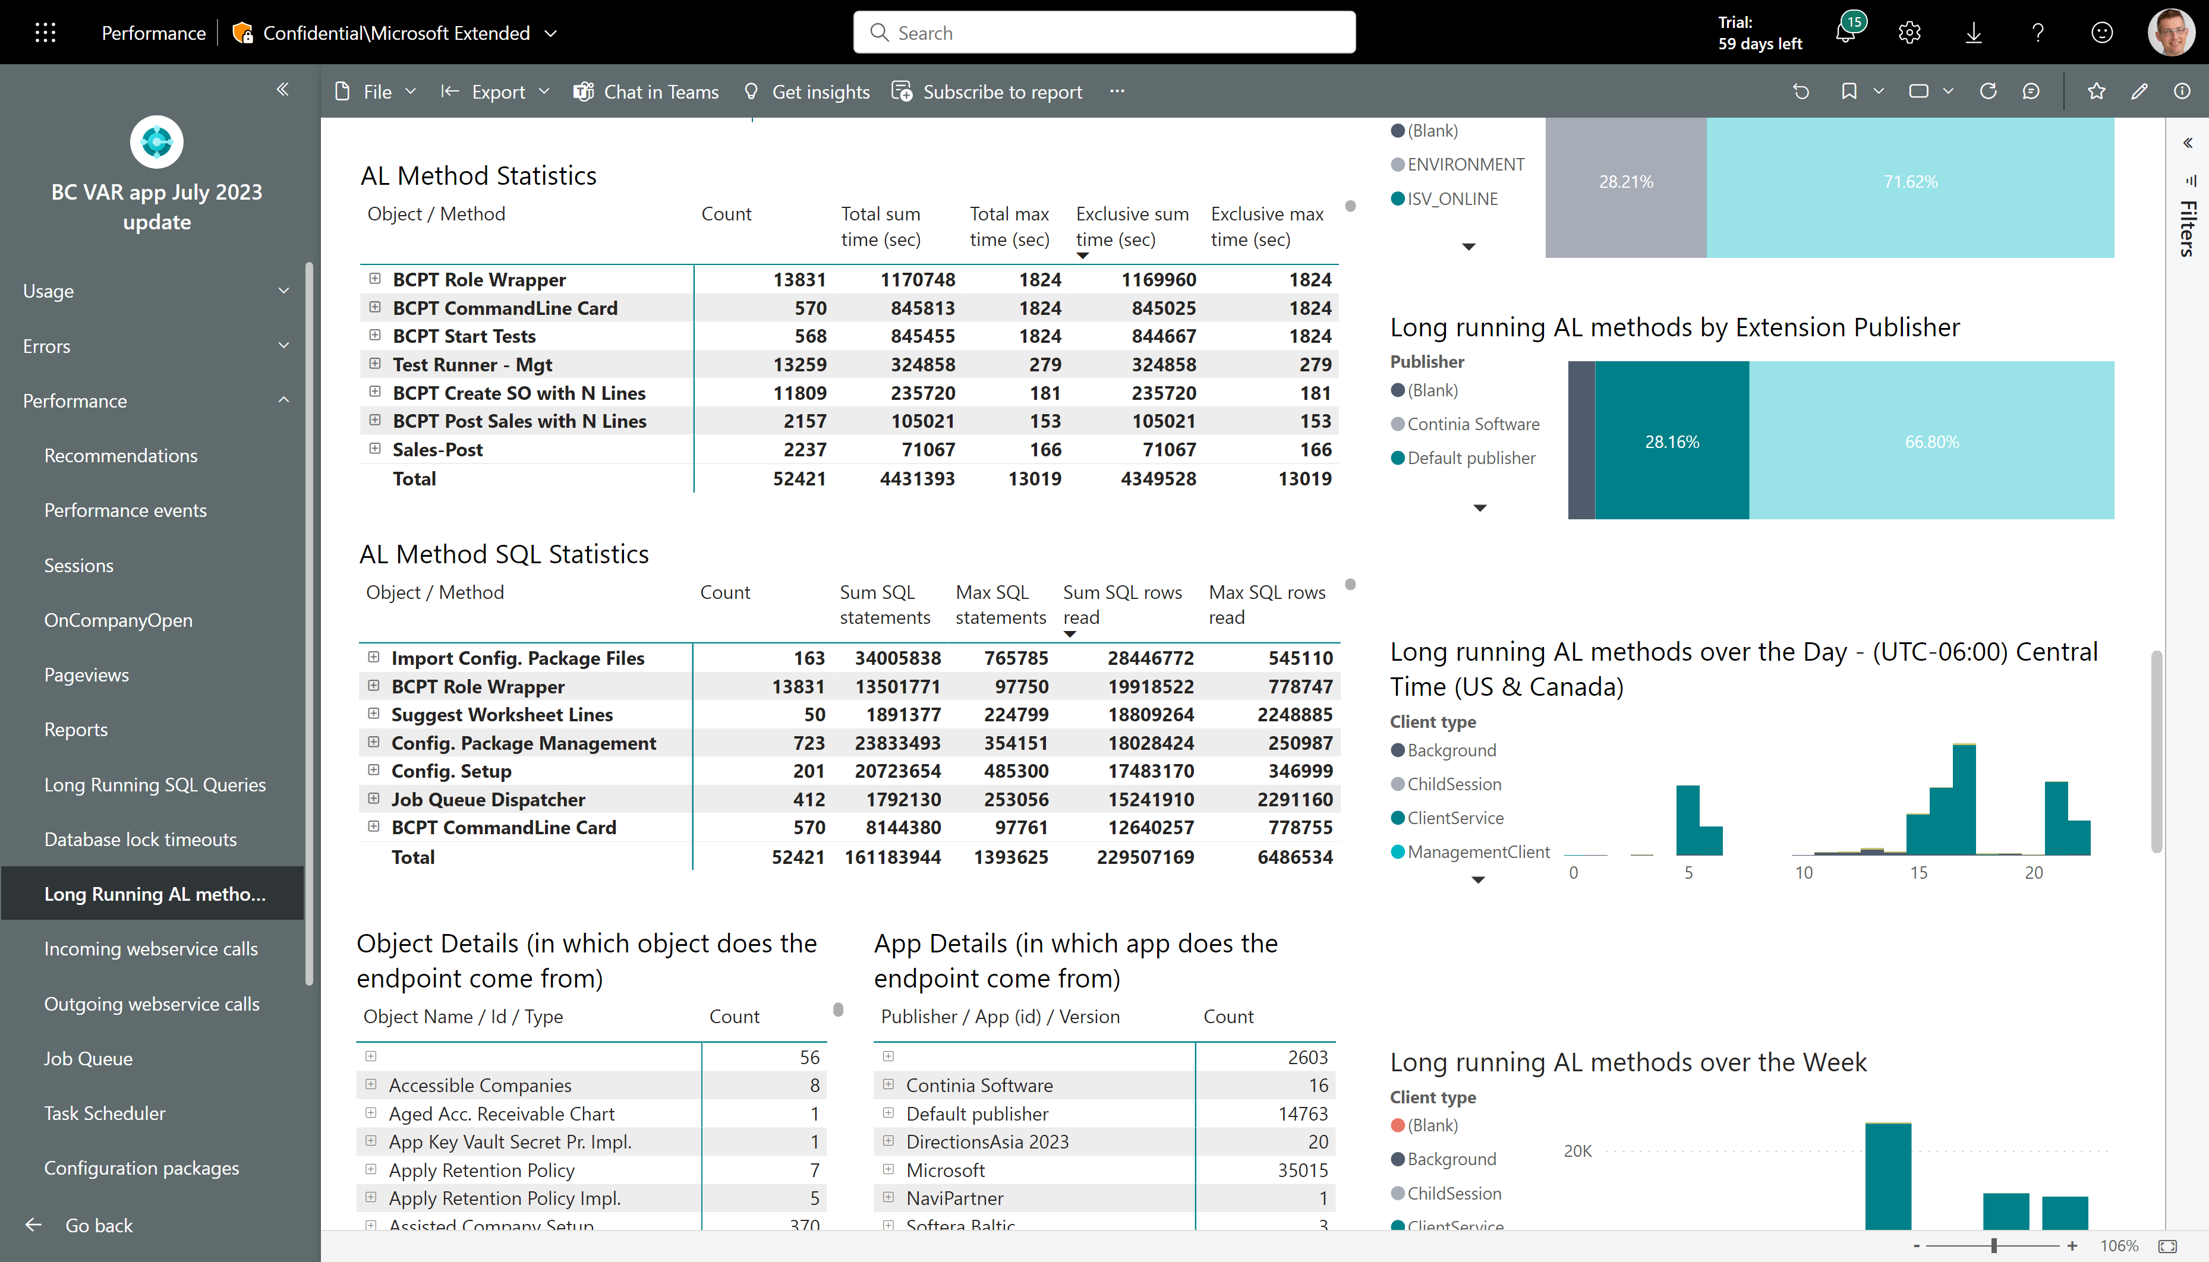
Long running AL methods – see SQL statistics
Now also shows SQL statistics for long running AL methods
SQL statistics can help you determine if a long running AL method is not only spending a lot of time running AL, but as well is also doing work on the database.
Note that the time captured in this event does not include time spend in SQL.

Slide 20
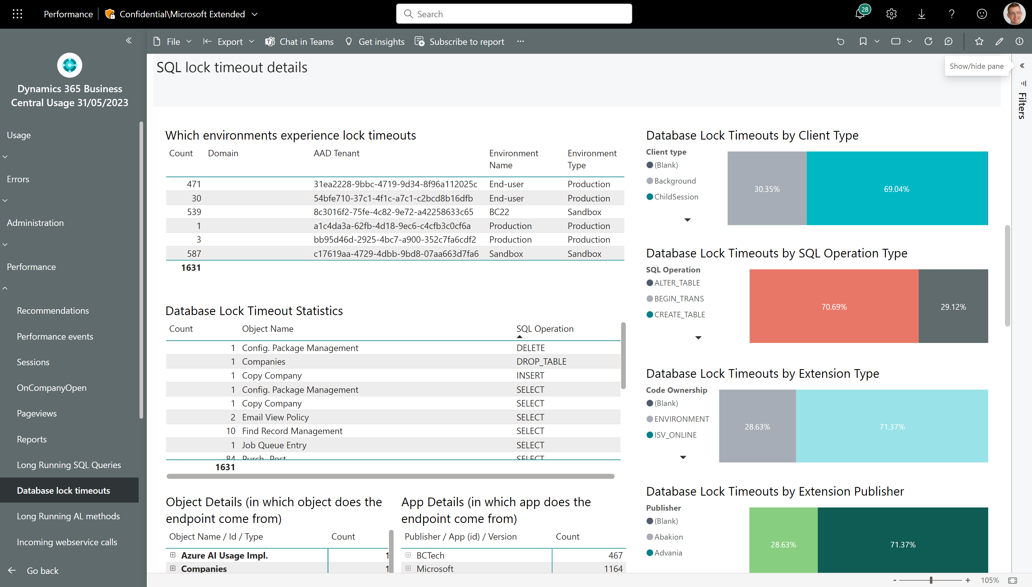
Analyzing database locks - 1
See impact across environments
UI or background sessions?
What type of SQL operation wanted to lock?
Which objects in which apps were affected?

Slide 21
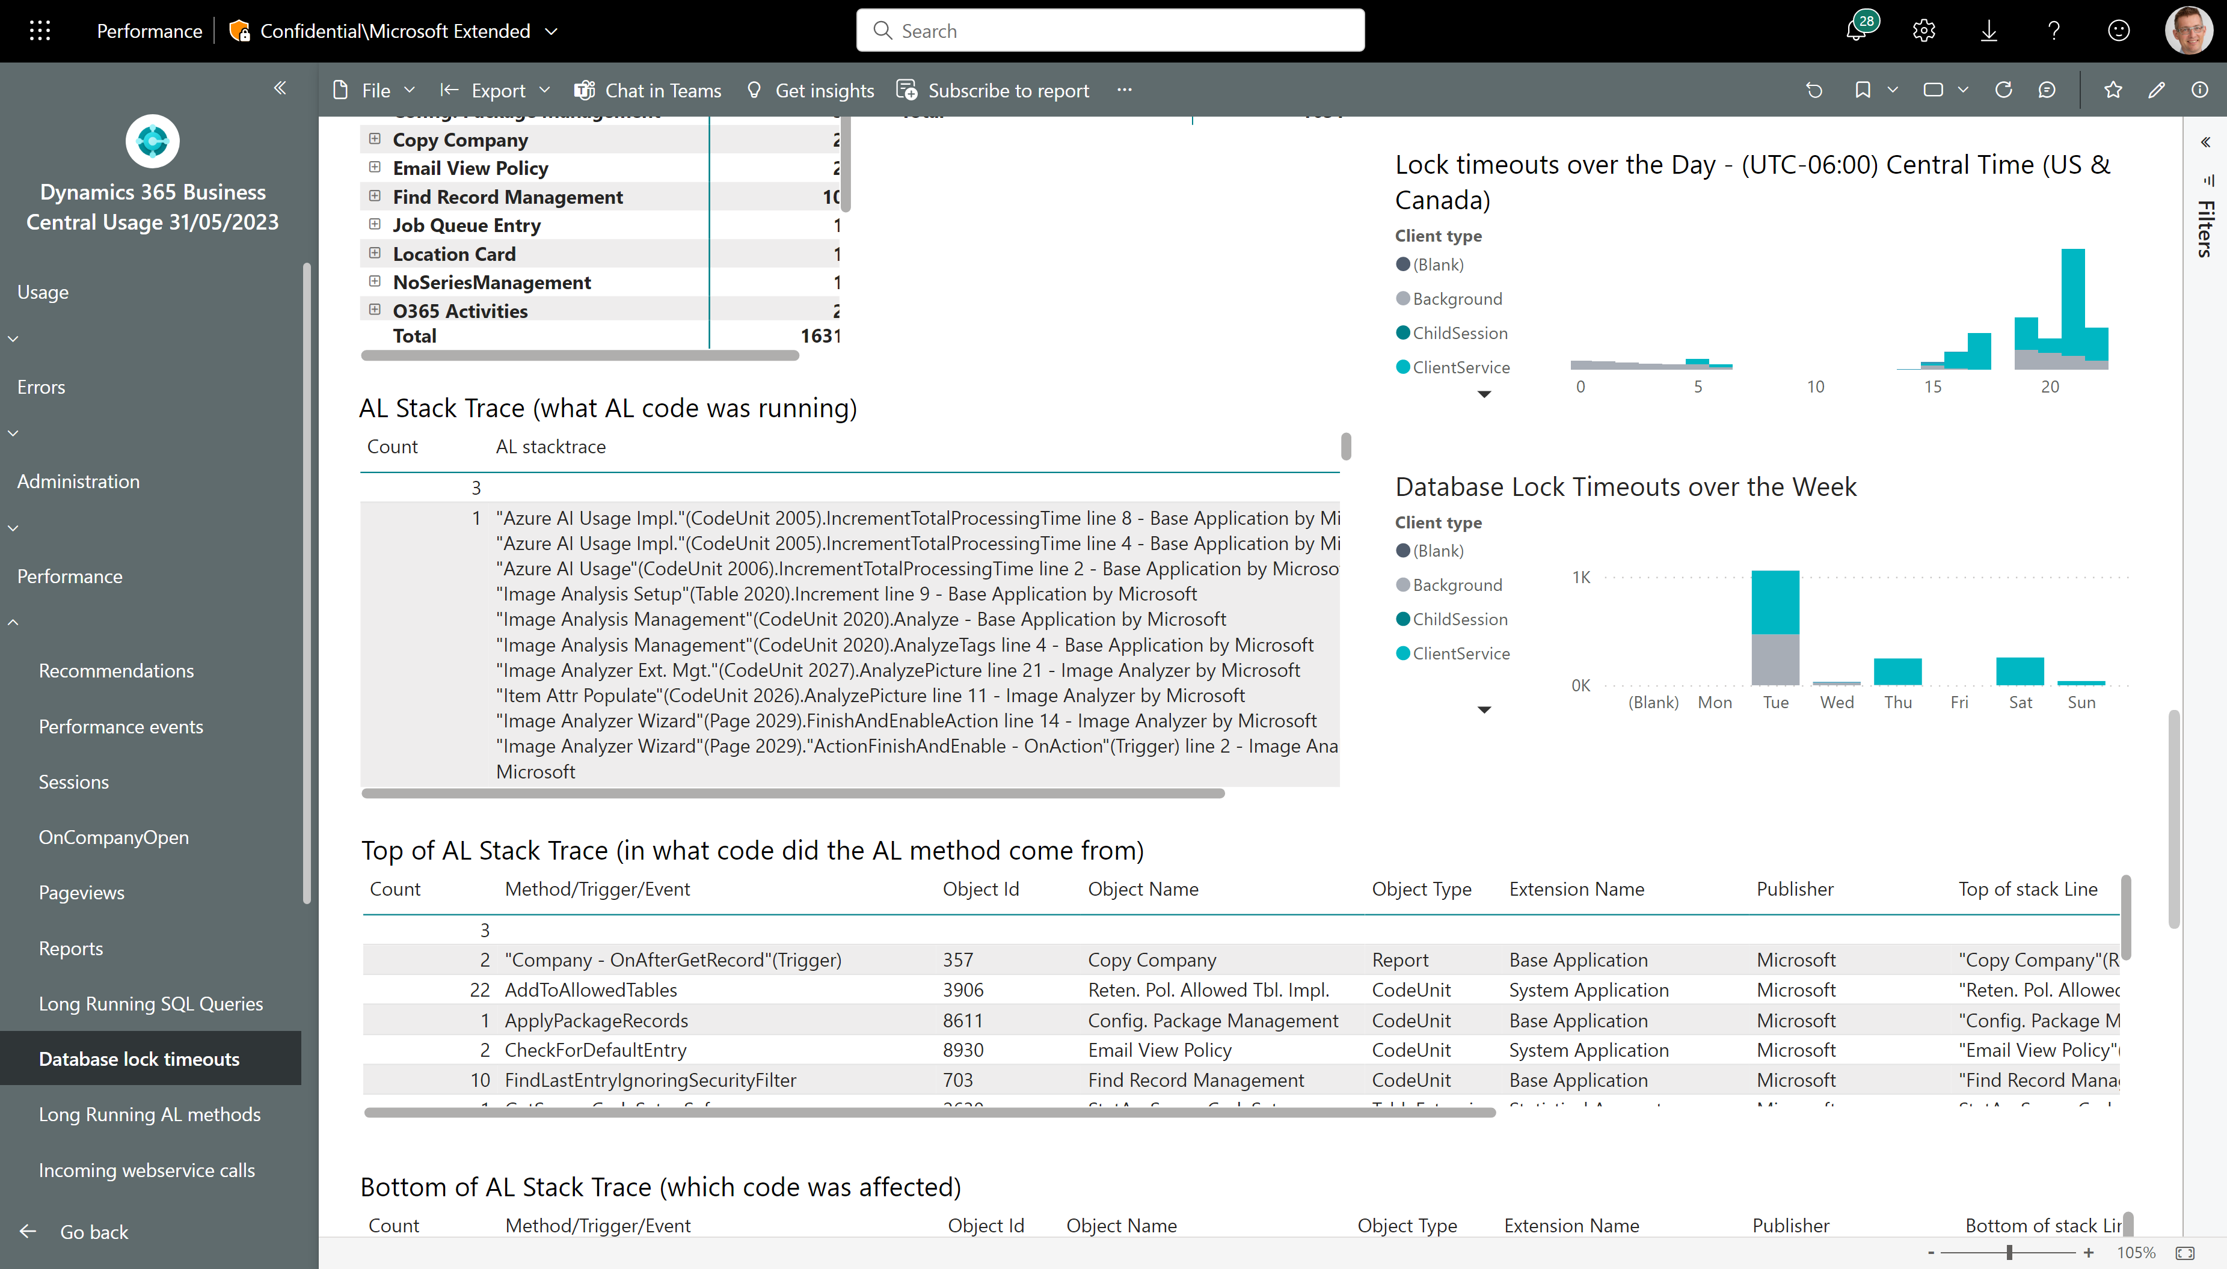
Analyzing database locks - 2
When is locking a problem? Maybe you can move some processing to run in the background and out of normal business hours?

Slide 22
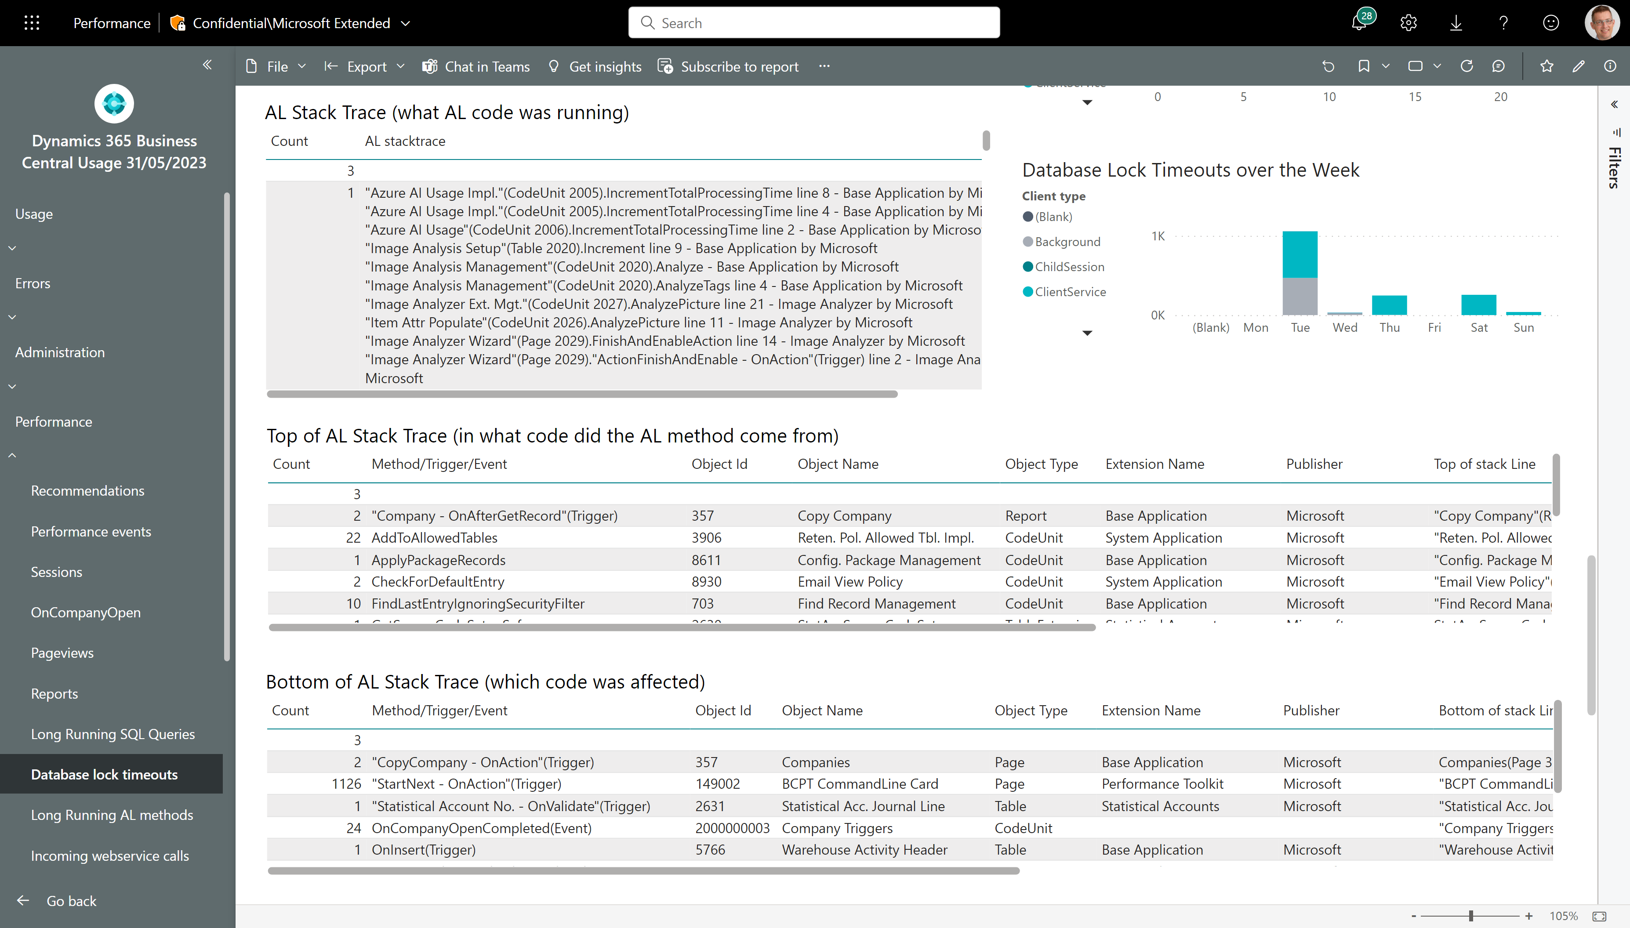
Analyzing database locks - 3
AL stacktrace analysis can help you determine
Which AL method tried to take locks?
Which AL method was interrupted by the lock timeout (this is what the user was doing)

Slide 23
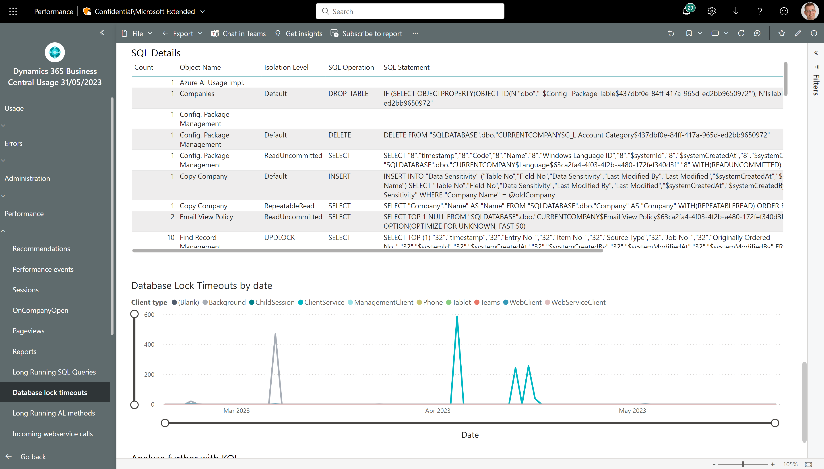
Analyzing database locks - 4
SQL analysis can help you determine
What type of operation tried to take the lock? If this is a SELECT statement, then look at isolation level below.
Which isolation level was used in the AL? Could you use the new construct XXX that was introduced in version 22 to remove this lock or reduce the impact of it?

Slide 24
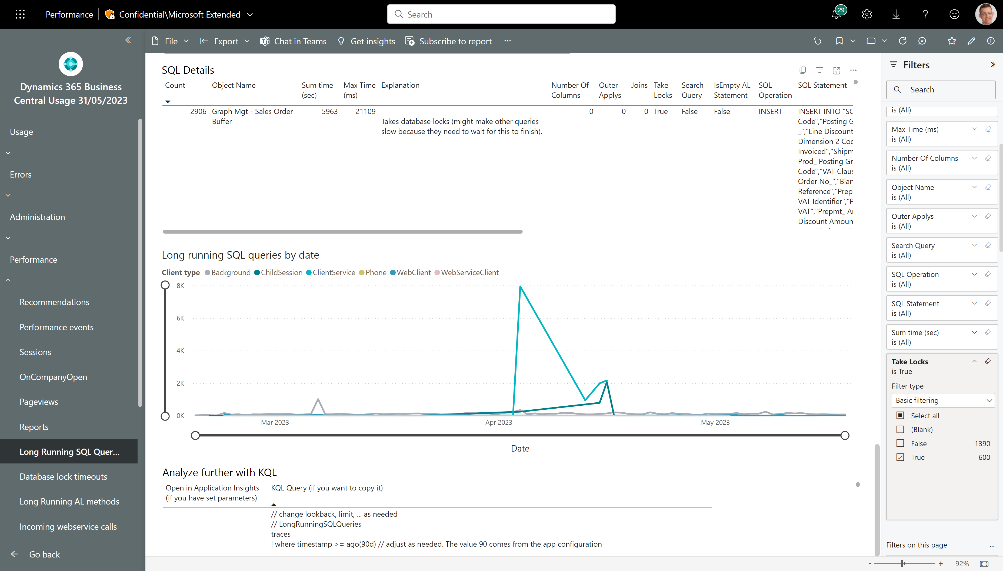
Analyzing database locks - 5
NB! This is the Long Running SQL Statements page
SQL analysis on this page can help you determine what other SQL statements were running at the same time as the statement that timed out? Note that you need to look at the timestamp 30 seconds prior to the lock timeout event.

Slide 25
Tuning incoming web service calls
Four things to consider:
Use APIs over OData/SOAP on UI pages
Reduce aggressive calls
Check time spend in queues
Fix non-200 HTTP errors (these just waste resources)
Check time spend in queues

Slide 26
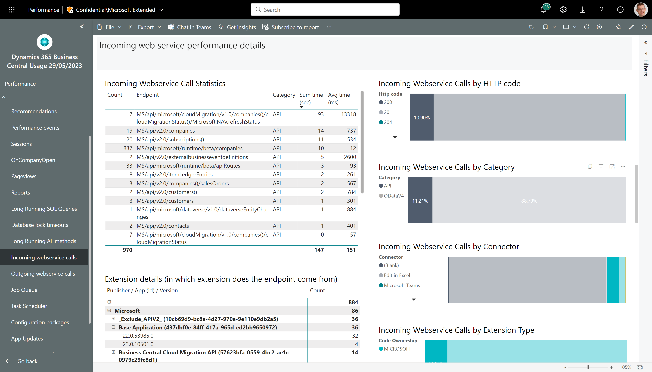
Is your API code fast?
Filter on category API

Slide 27
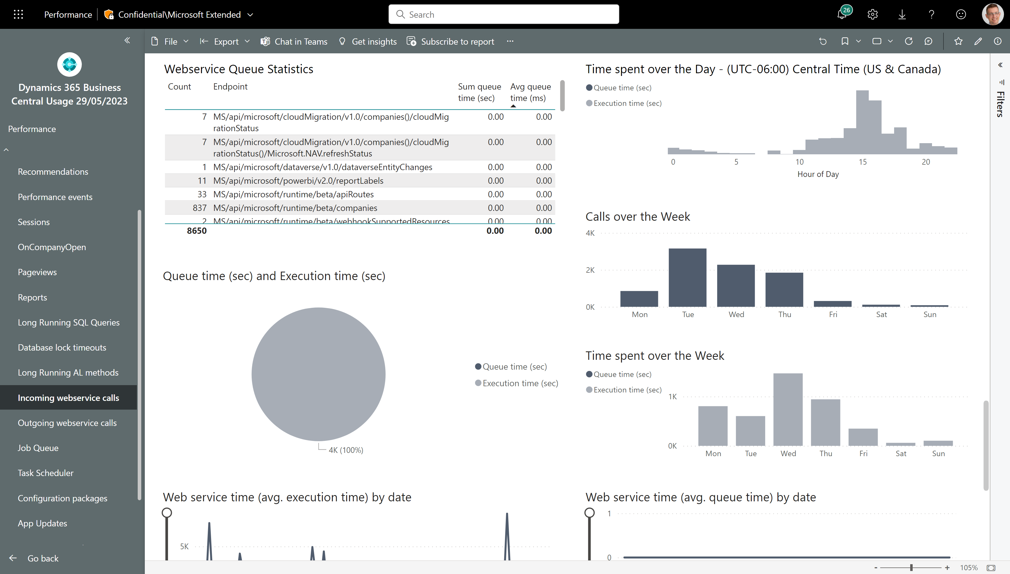
Does your API calls get queued up?
Queue time statistics, anyone?

Slide 28
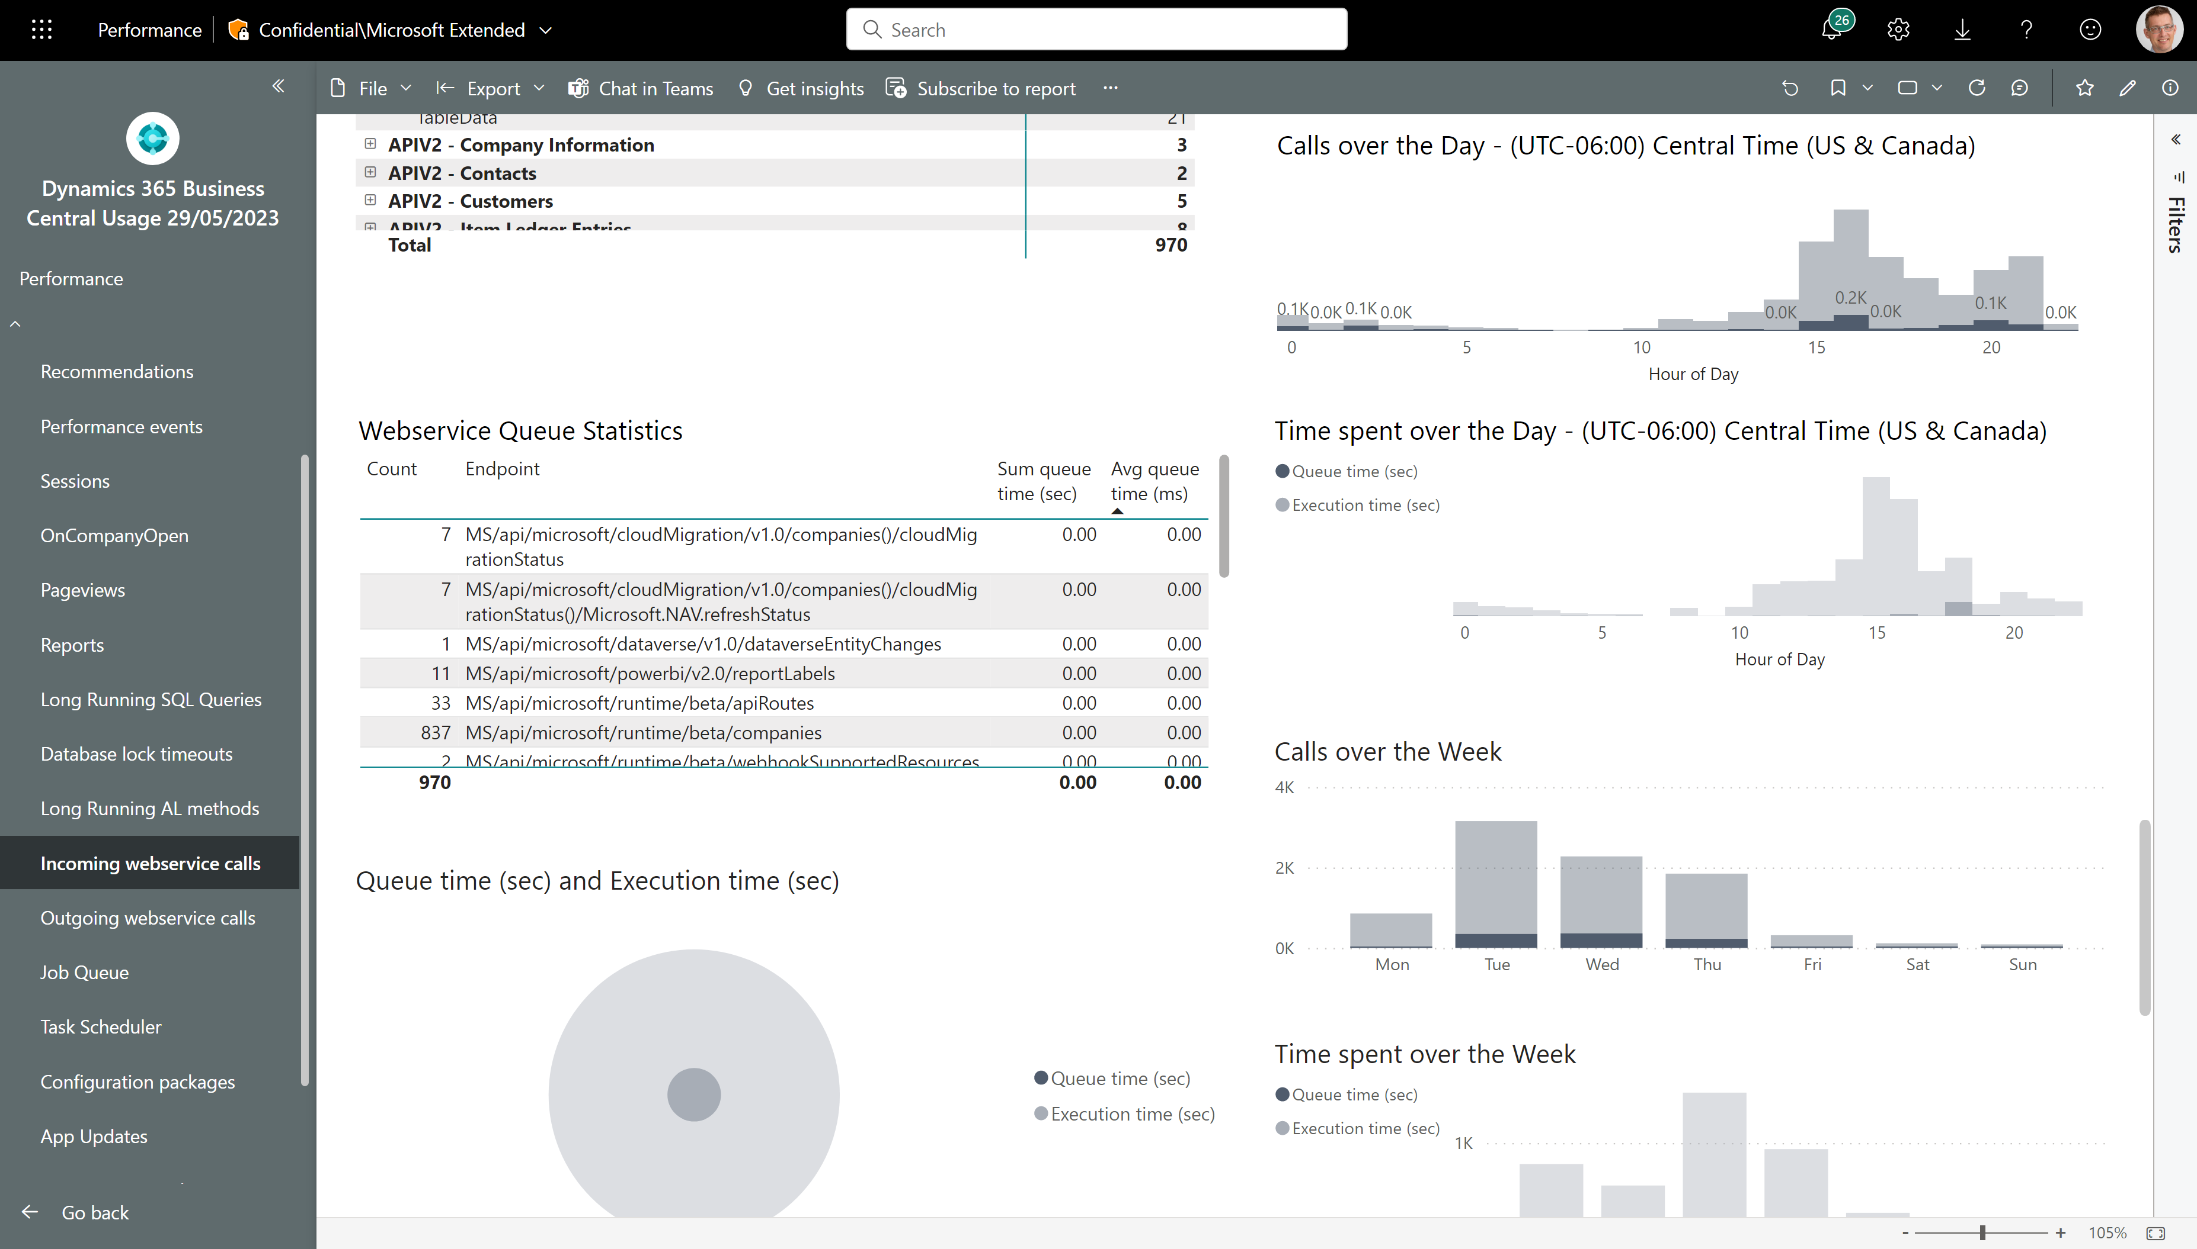
Are you calling APIs aggressively?

Slide 29
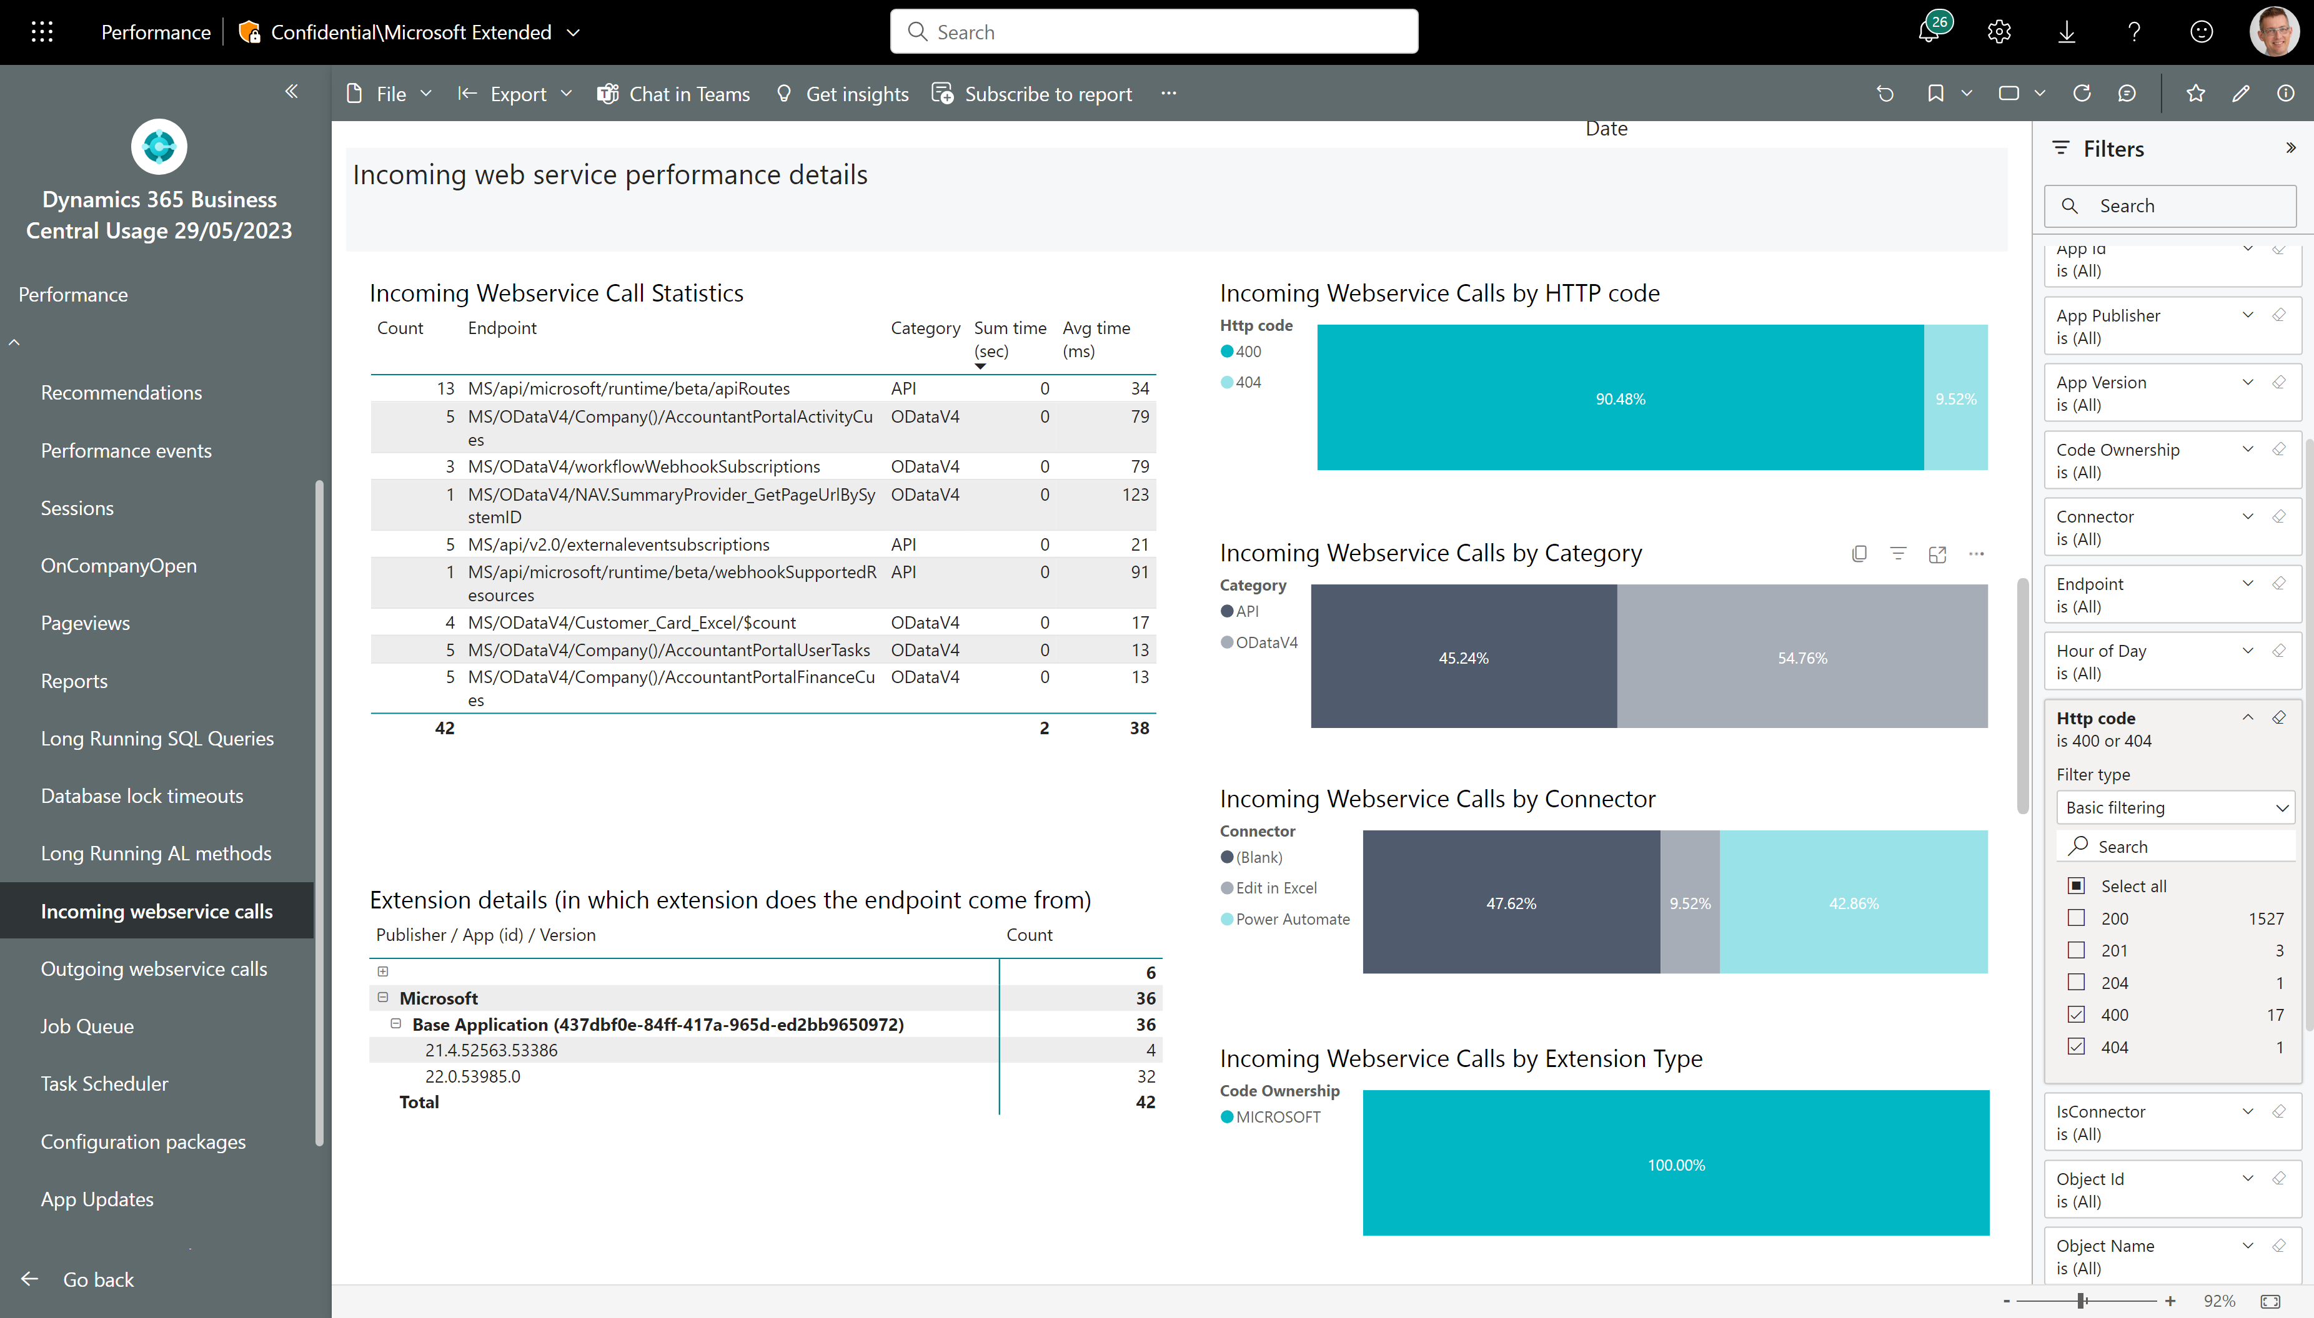
Incoming web service performance – non-200 calls
Fix errors on these endpoints
Filter to only show errors

Slide 30
Tuning outgoing web service calls
Four things to consider:
Tune slow endpoints
Reduce aggressive calls
Fix non-200 HTTP errors (these just waste resources)
Check outgoing web service calls in UI sessions

Slide 31
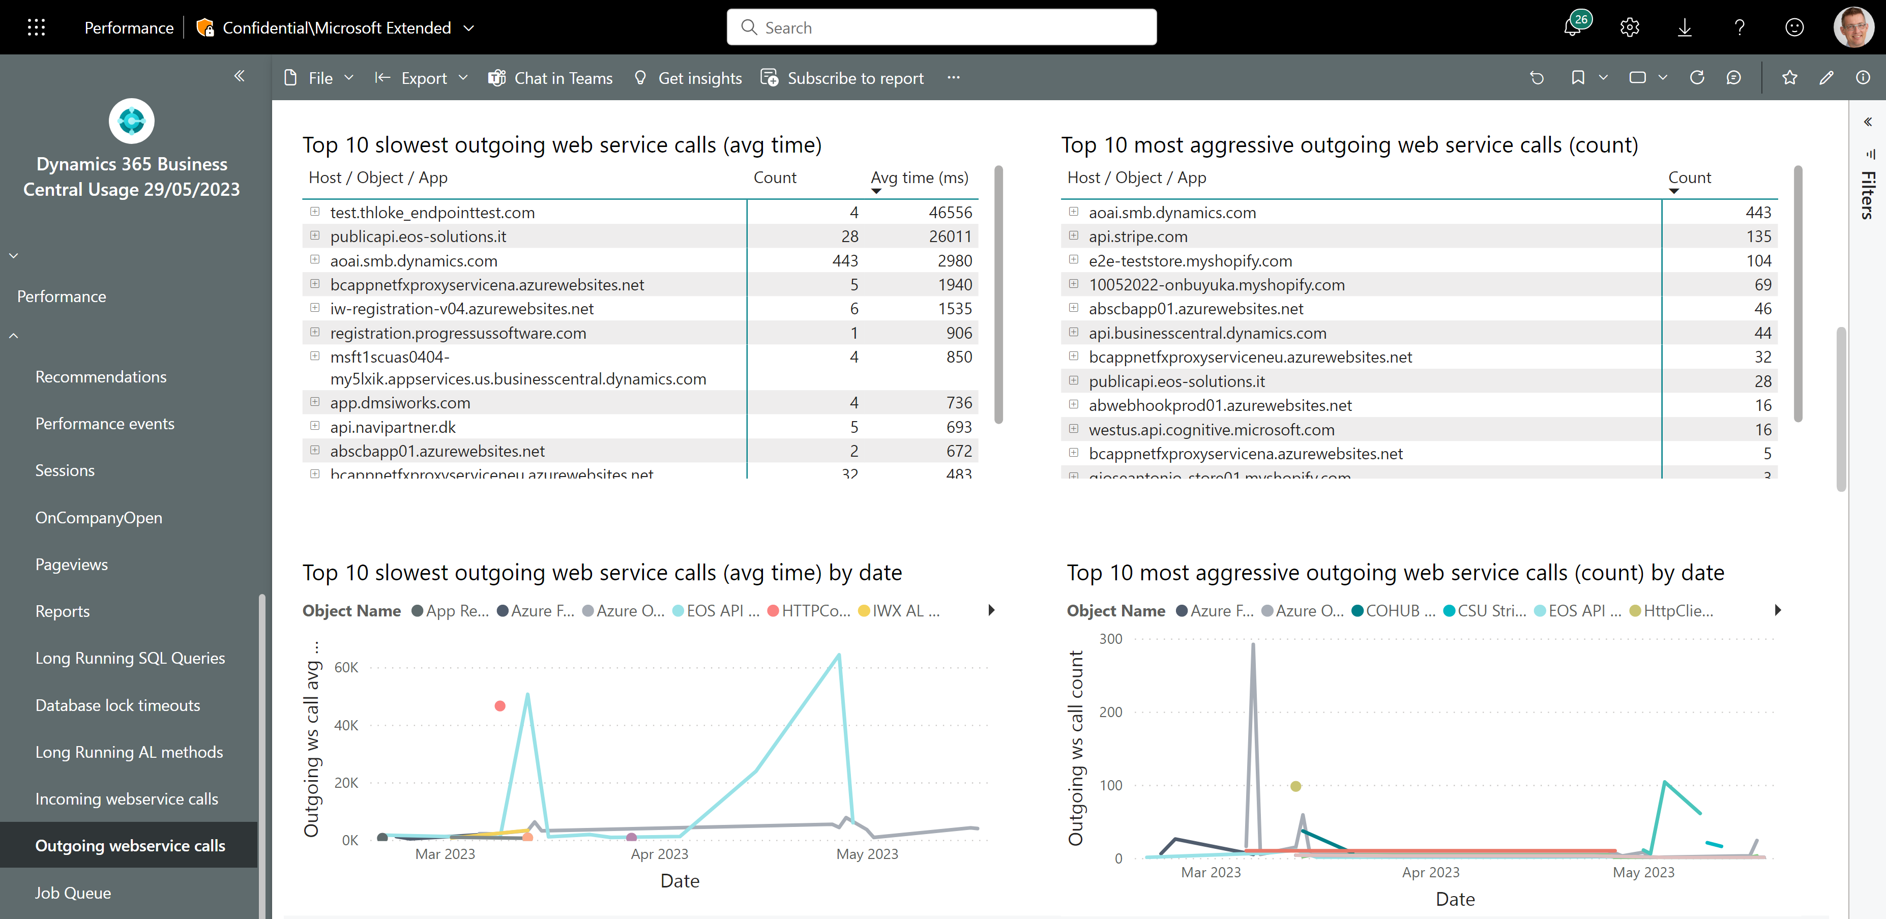
Outgoing web service performance - 1
Tune slow endpoints
Reduce aggressive calls

Slide 32
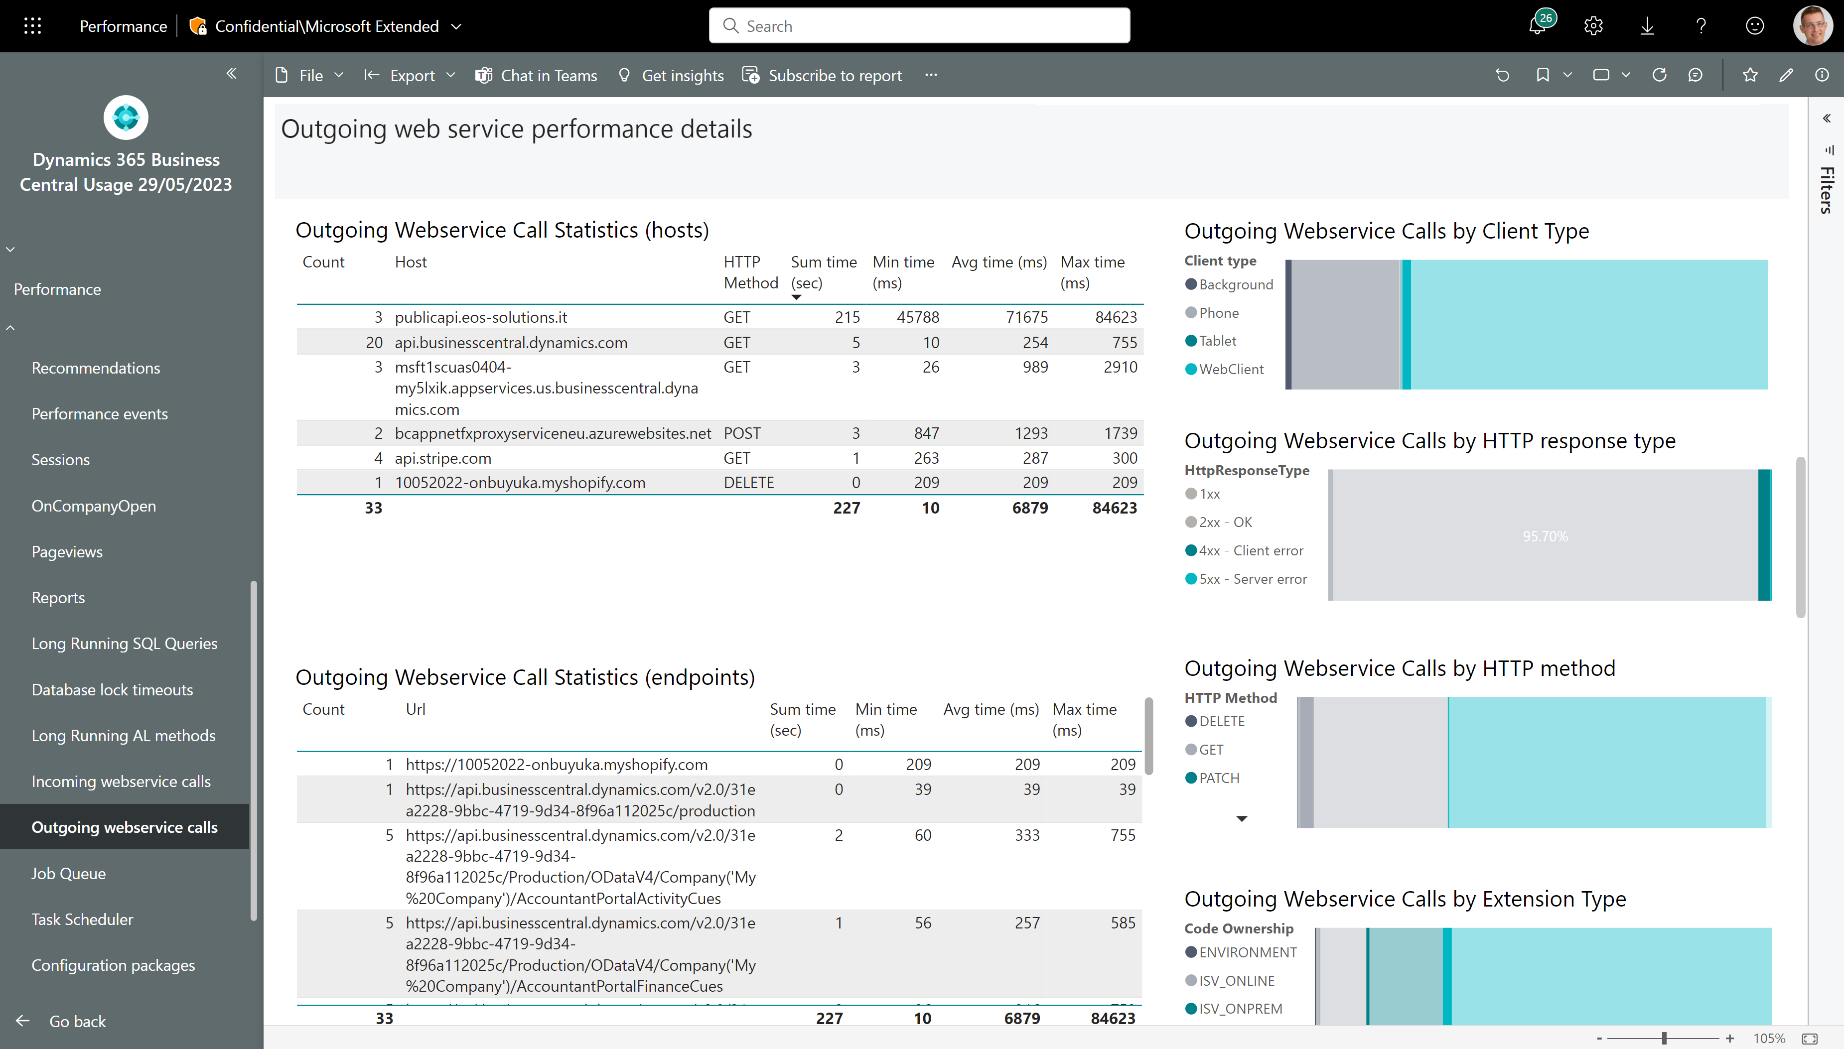
Outgoing web service performance - 2
Fix errors on these endpoints
Filter to only show errors

Slide 33
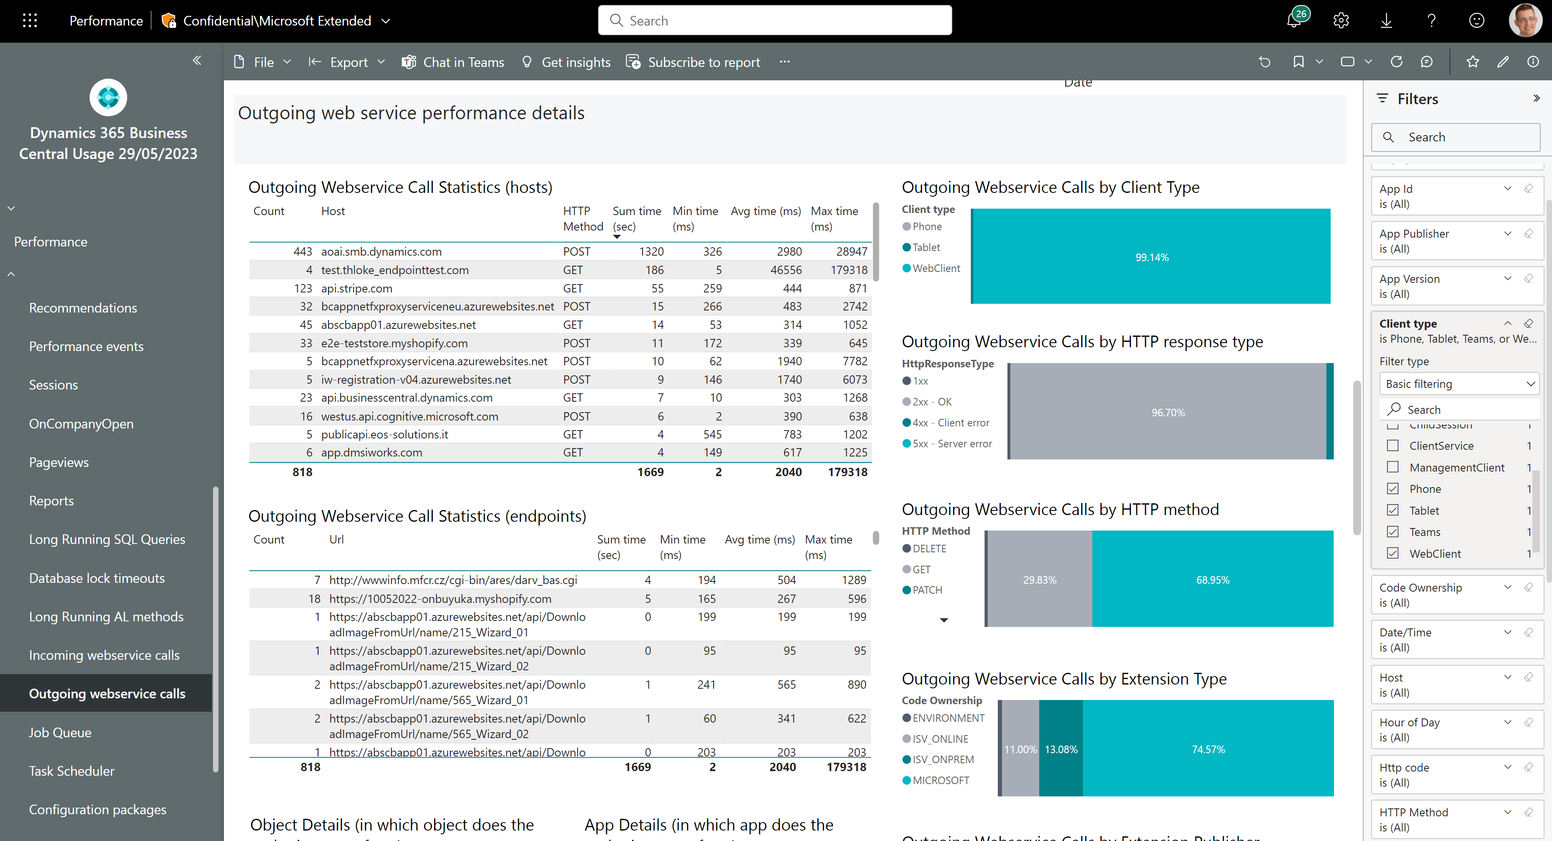
Outgoing web service performance - 3
Tune these – users wait for them in the UI
Filter to only show UI clients

Slide 34
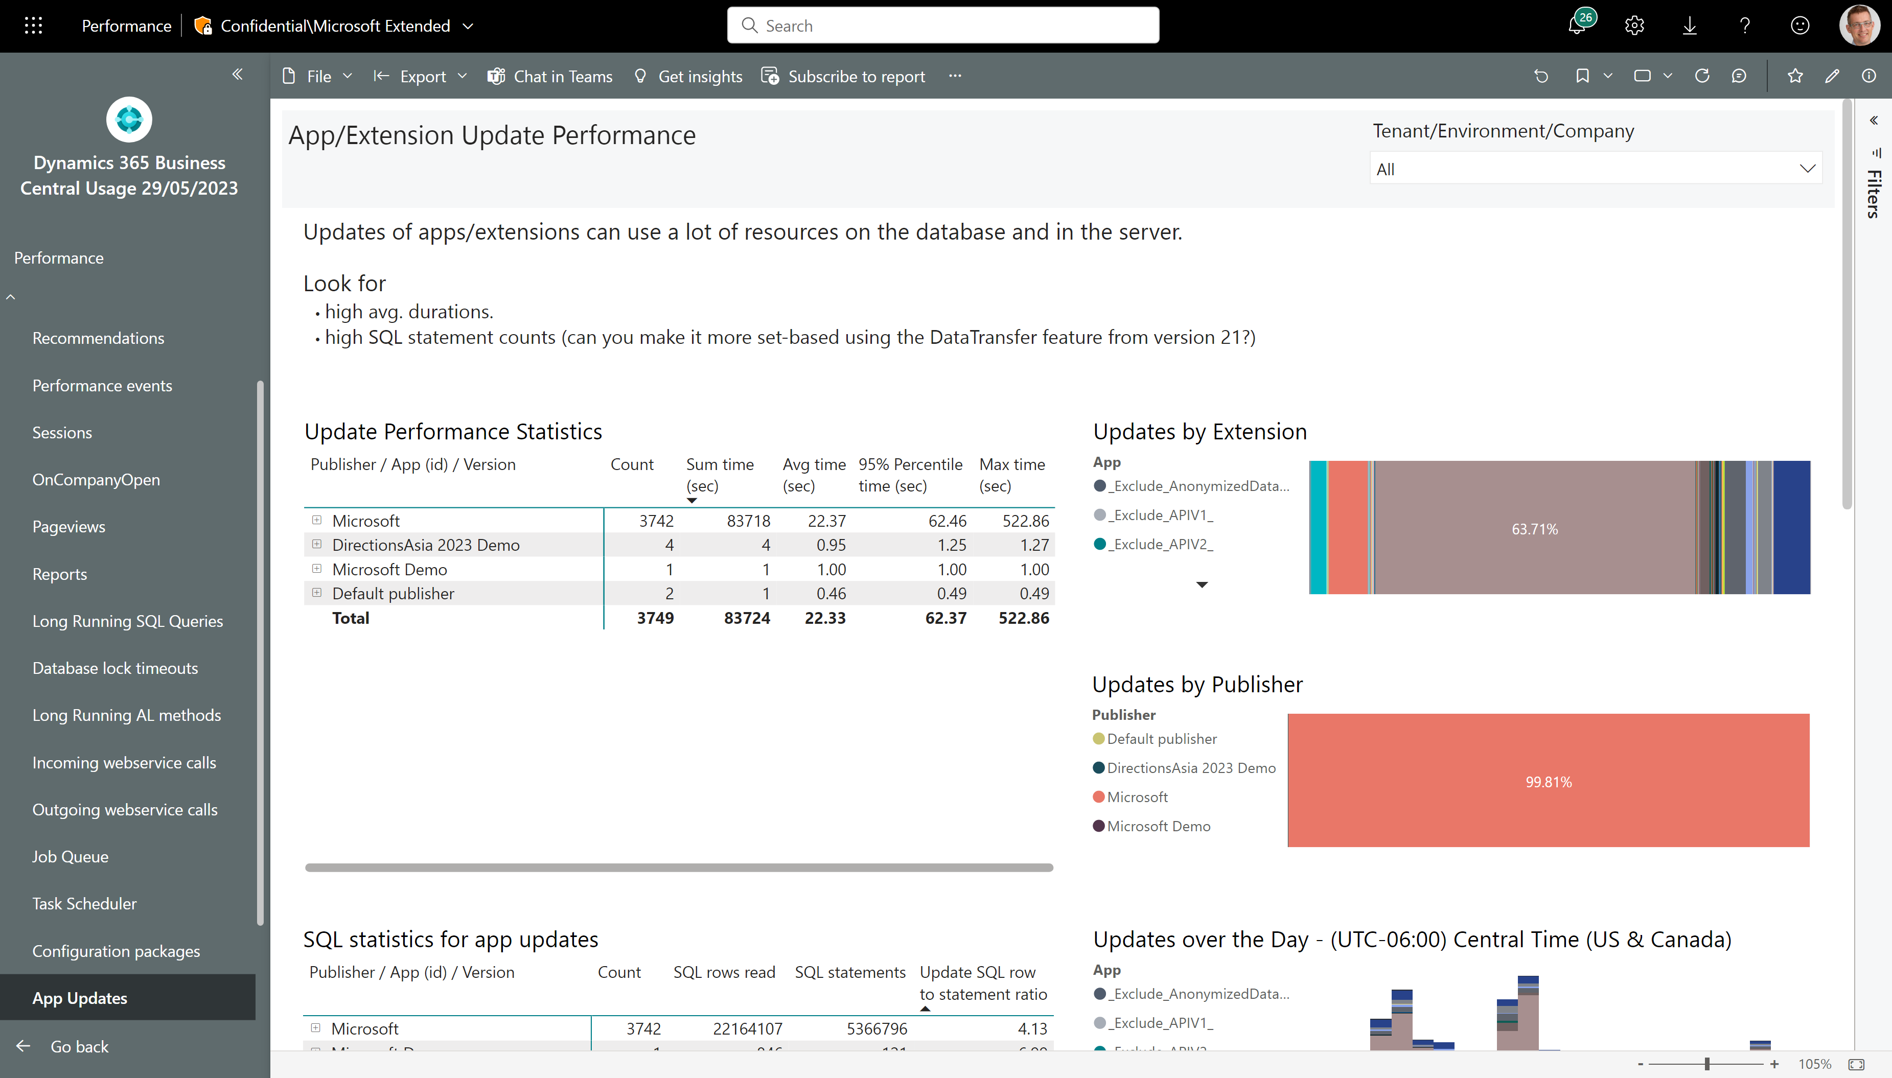
Update performance – do you use DataTransfer?
Any app updates take long time?
How set-based is the update code?

Slide 35
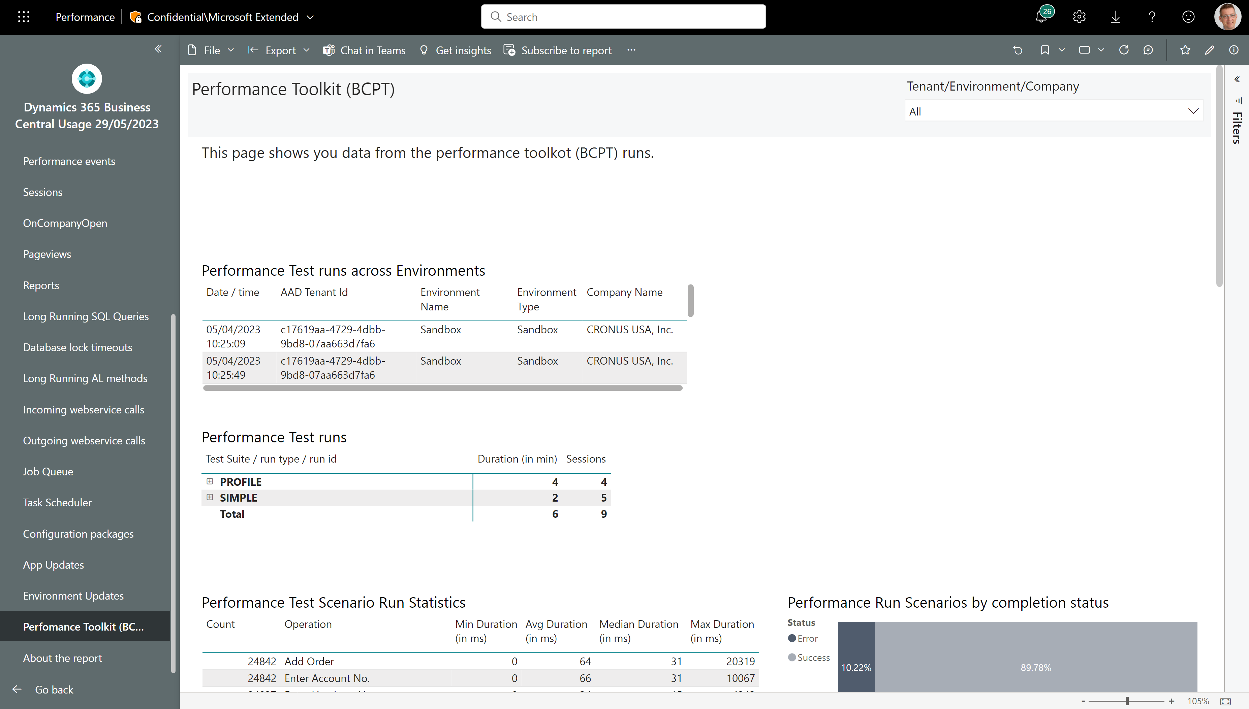
Track performance test results – also over time
Any test runs that take a long time?
What are the timings for the different scenarios?

Slide 36
Administration

Slide 37
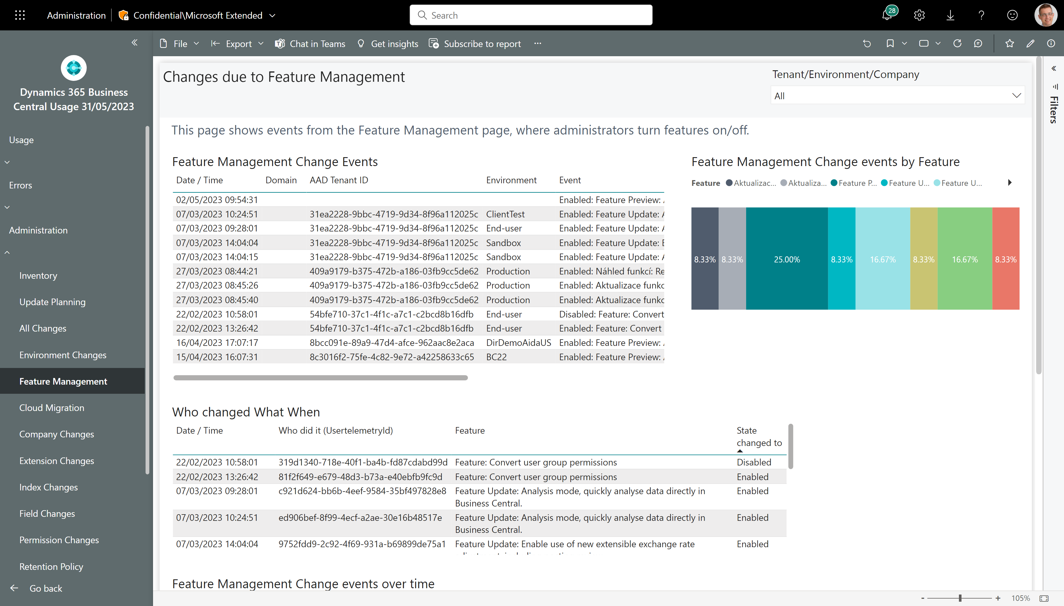
Track changes to Feature Management switches
See changes across all environments
Who did it?
And when?

Slide 38
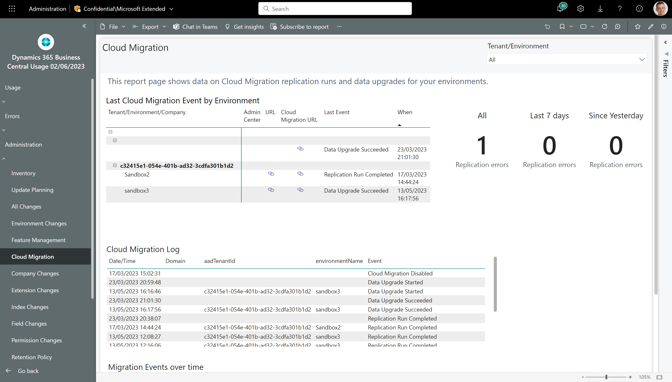
Track progress to cloud migrations
Error KPIs that work with Power BI metrics
What is current status across environments?
Browse the log
Track things over time

Slide 39
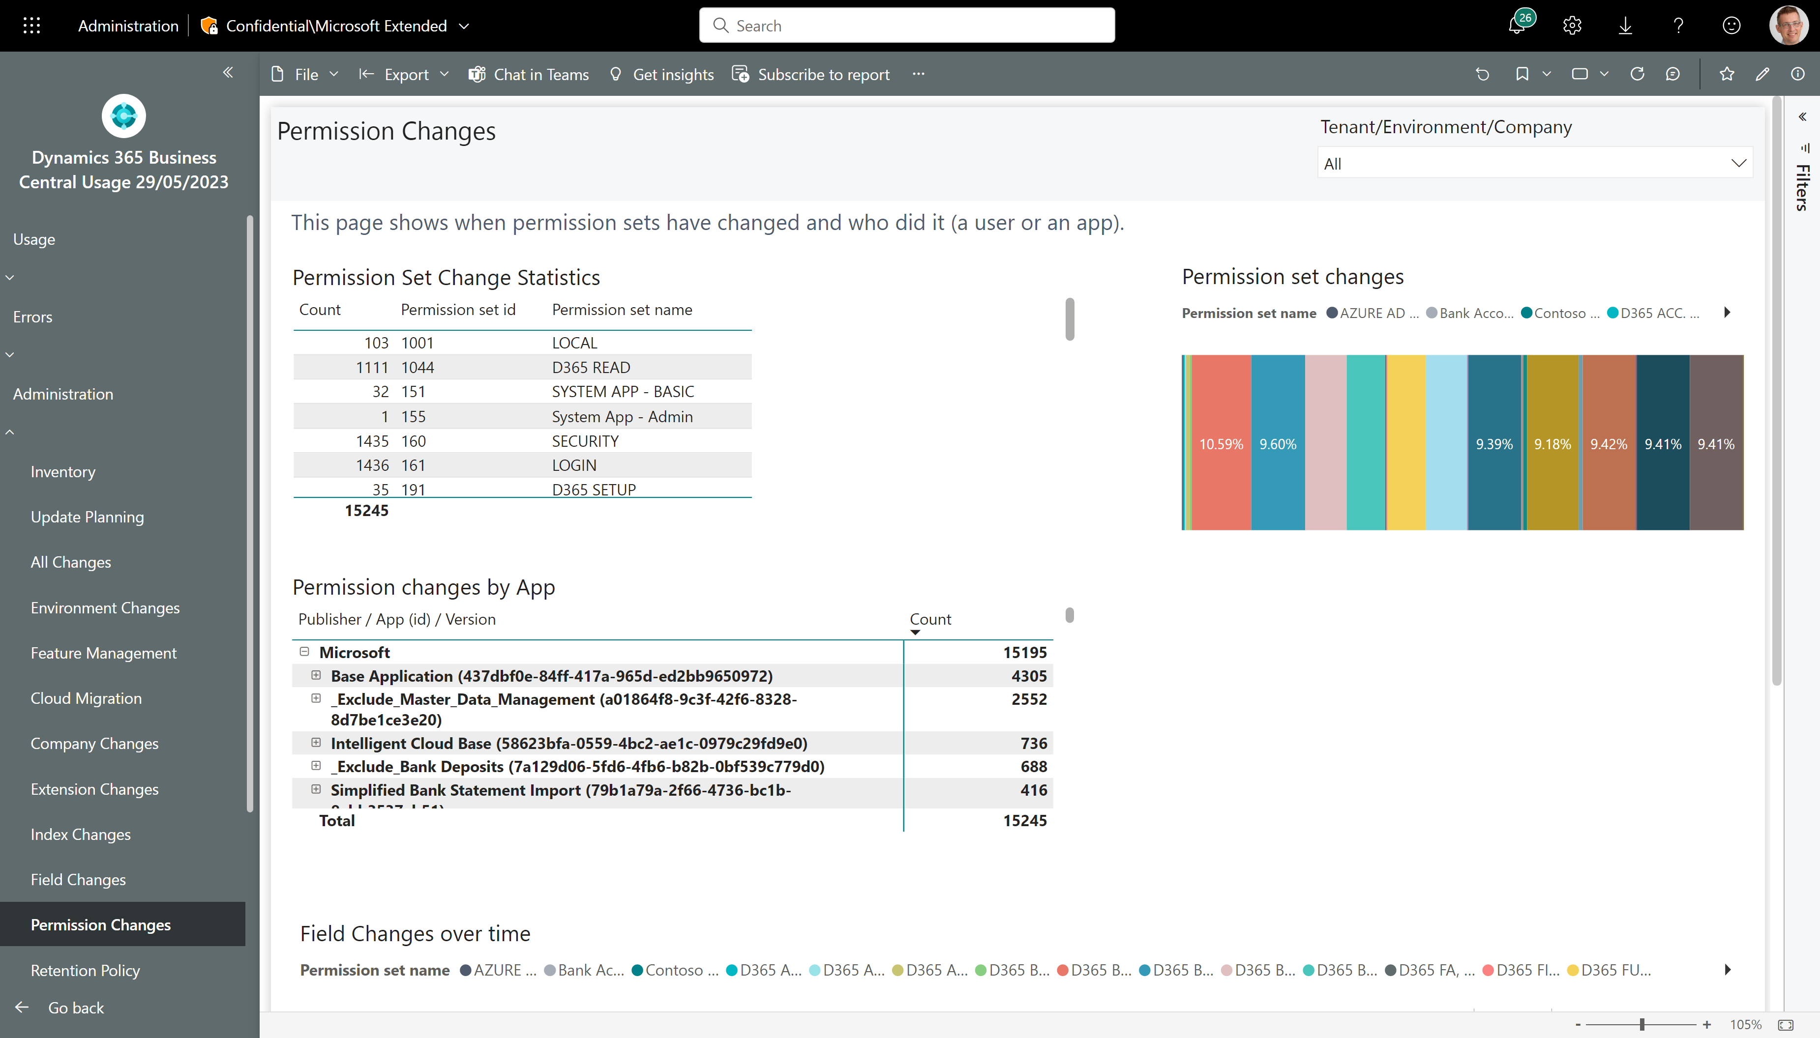
Track changes to permissions (also over time)
Which permission sets were changed?
And by which apps?
And when?

Slide 40
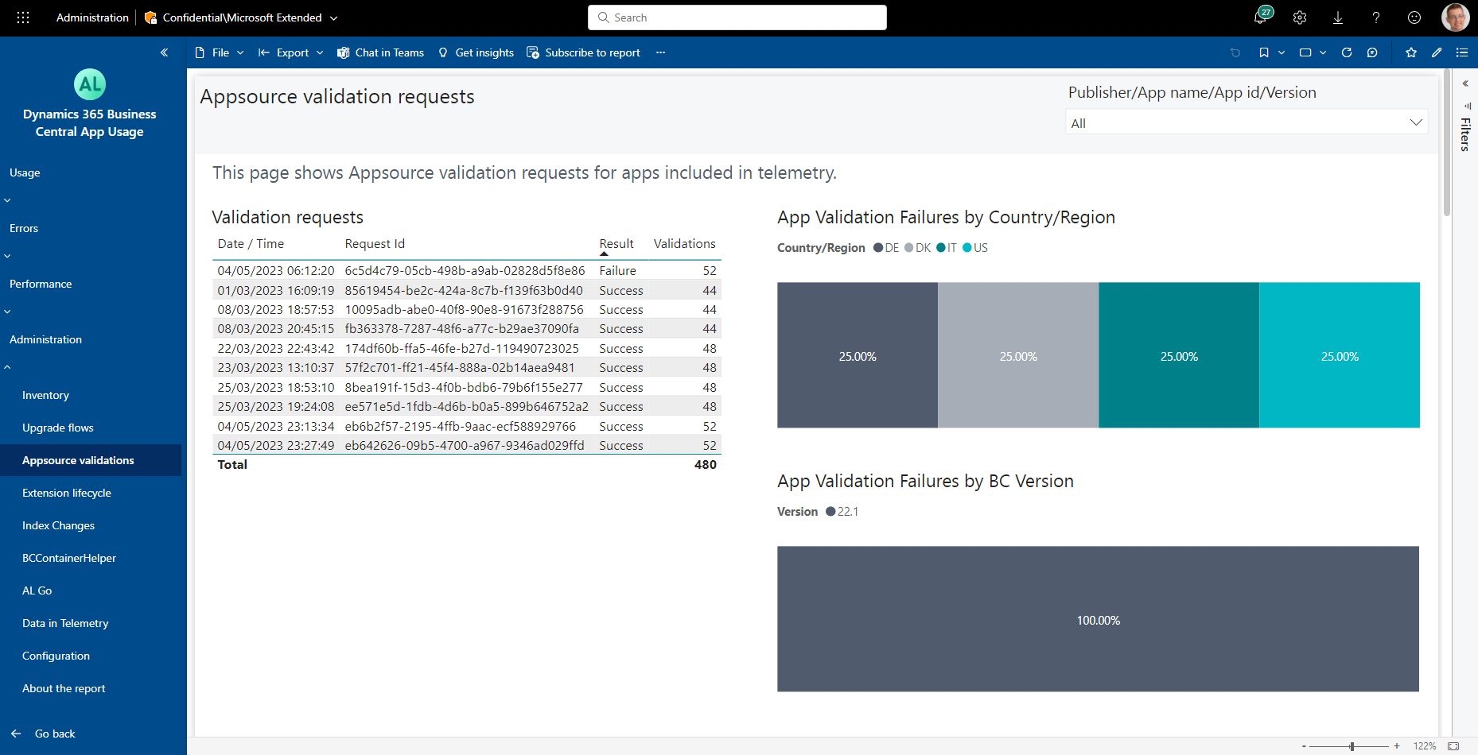
How to see the Appsource validation results
See failures by country/region
See failure rates by version

Slide 41
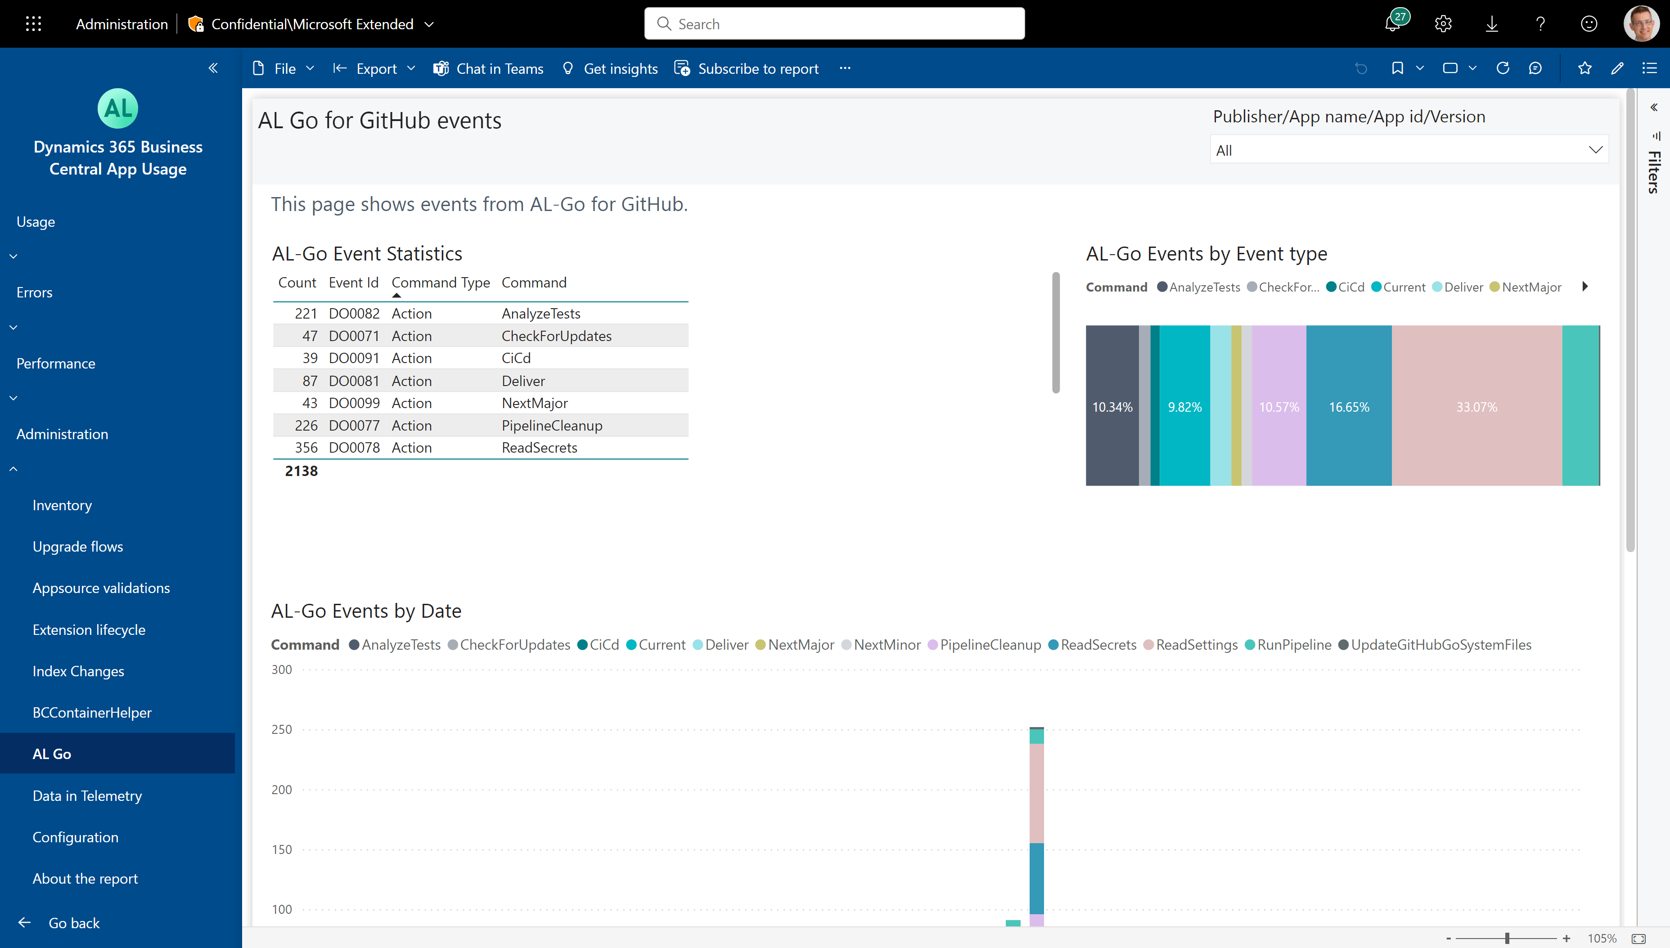
How to see the usage of AL-GO for Github

